Slide 1
Three Trichophorum taxa ~ ID & ecology
Jeremy Roberts, February 2020

Slide 2
Links to:
a lot more more information on the genus,
e.g. a downloadable field-guide:
…and next, some history…

Slide 3
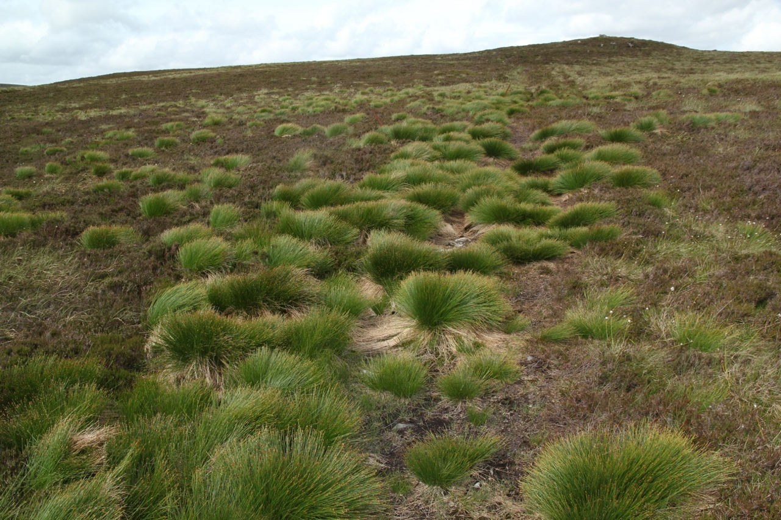
Linnaeus’ single species, Scirpus caespitosus L. was moved by C.J. Hartman to the genus Trichophorum in 1849

Slide 4
Two deergrass taxa, LONG known! – here recognised as SUBspecies
Eduard Palla
(d. 1922)→
… T. germanicum
In ‘Clapham, Tutin & Warburg’ Ed. 2
(1962)
←
useful drawing!

Slide 5
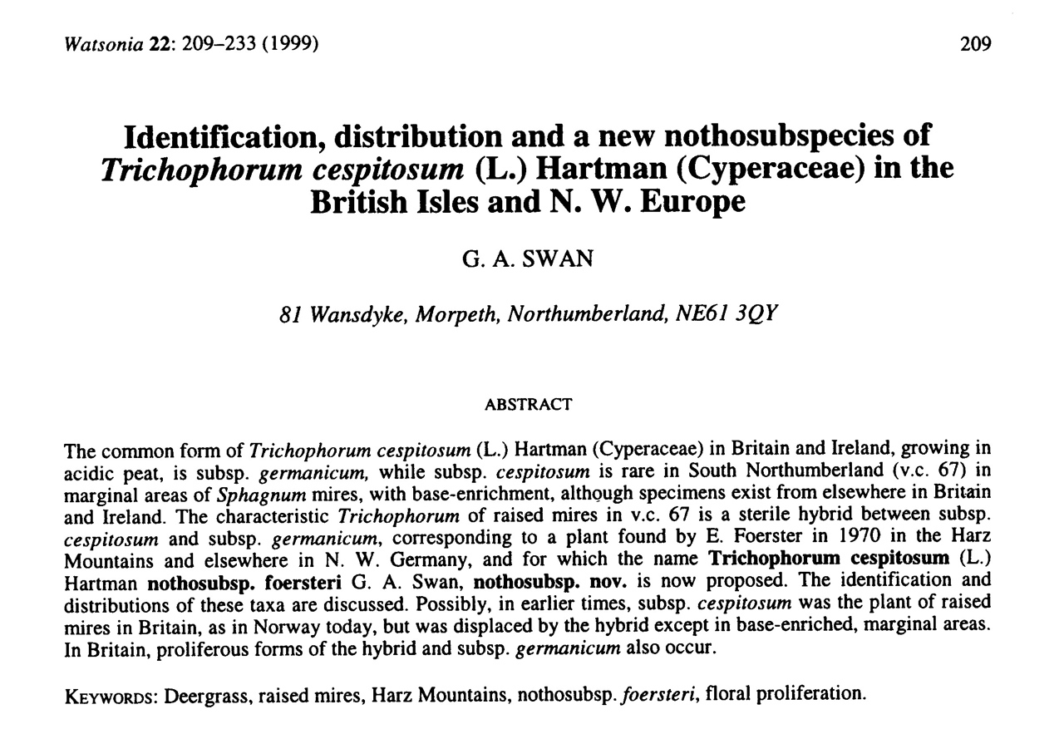
1999: two SUBspecies – and recognition of a frequent hybrid
[with a not-very-memorable name!]:

Slide 6
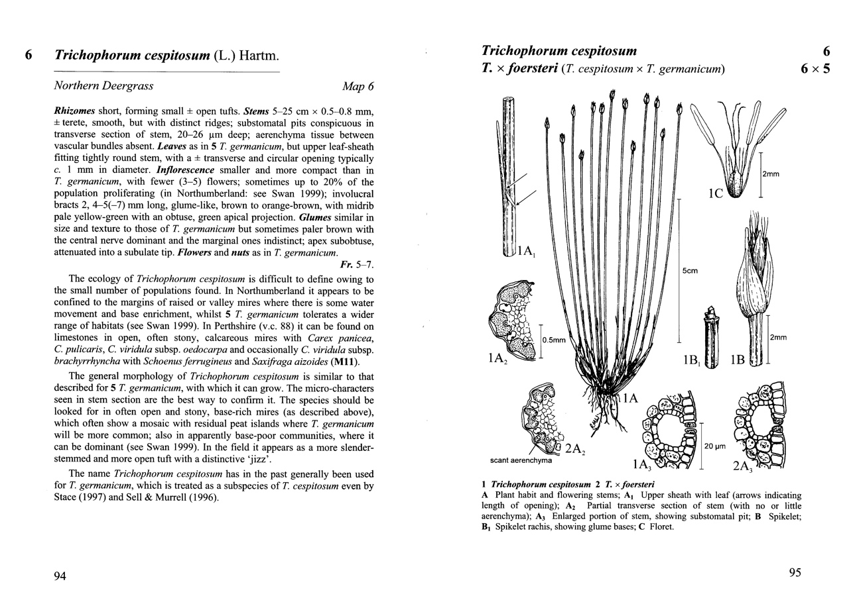
2007: now two SPECIES – and the hybrid gets a much nicer binomial!:
the common species is now germanicum; the rare species is cespitosum
Sedges of the British Isles (BSBI, 2007)

Slide 7
…so now we have three taxa…

Slide 8
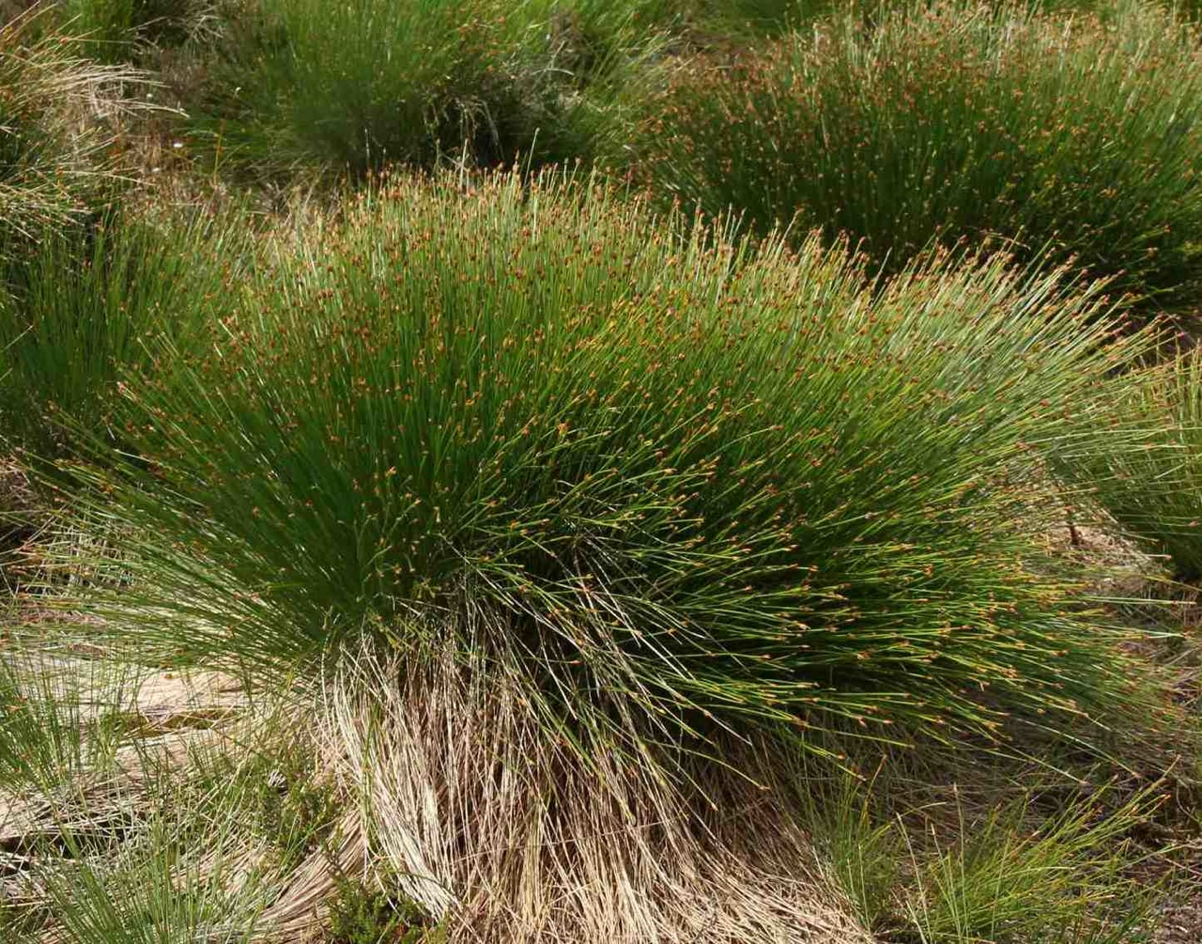
Common Deergrass
Trichophorum germanicum

Slide 9
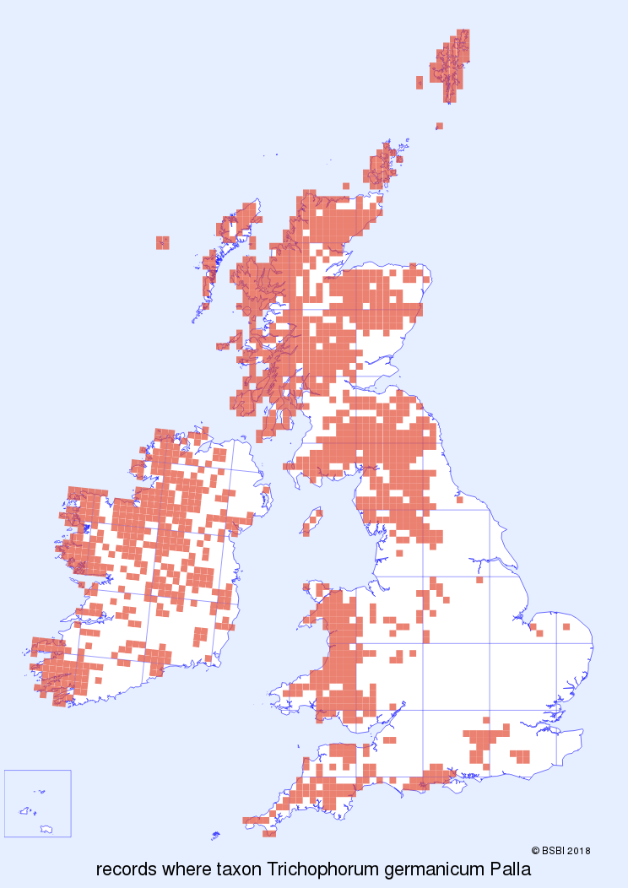
Common Deergrass
T. germanicum
a local ‘Atlantic-subtlantic’ species
[shallow] peaty soils: blanket bog and wet heath
British Isles, ‘lower regions’ of Sweden, Denmark, France and Germany

Slide 10
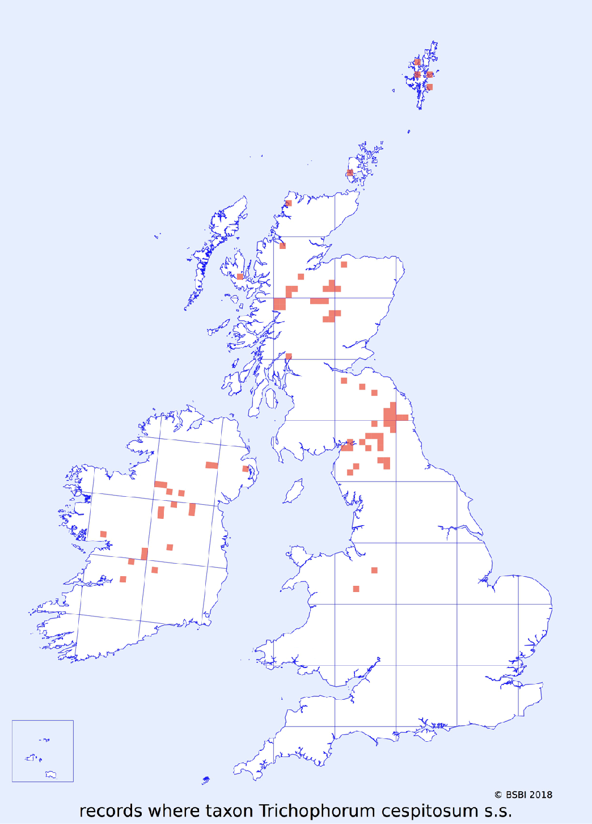
Northern Deergrass
Trichophorum cespitosum s.s. (=‘sensu stricto’)
arctic-alpine; circumpolar
base-rich habitats and deep peat mires
Widespread in northern and central Europe
[grateful thanks to Andy Amphlett for ‘sorting’ the DDb data for this map!]
(19th C)

Slide 11
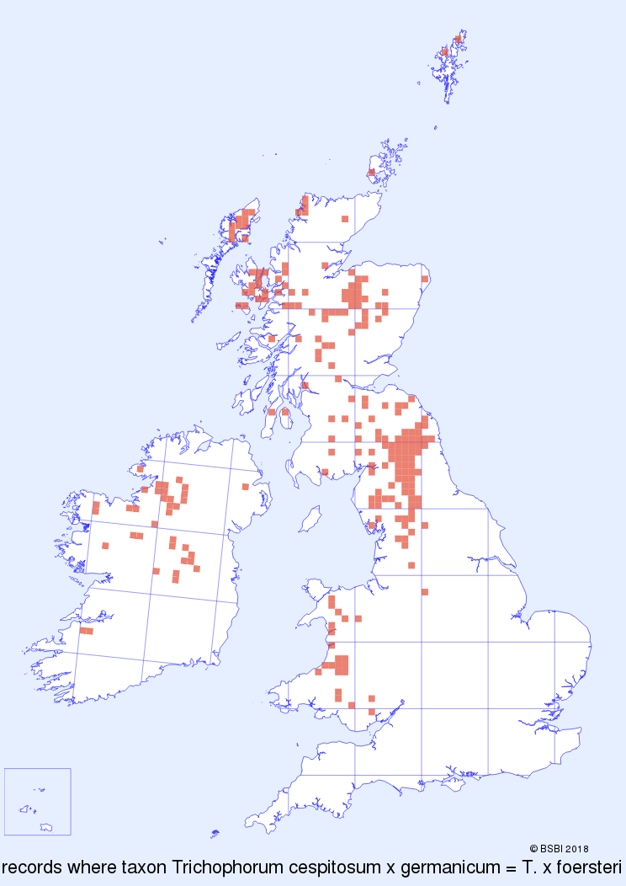
… and the pesky hybrid,
Trichophorum × foersteri
…of which more anon.
Hybrid Deergrass
Trichophorum × foersteri
in overlap zone of parent species:
‘Atlantic-subtlantic’
base-rich habitats and deep peat mires
NB: widespread in Wales, where cespitosum parent not yet found

Slide 12
Where to seek Northern Deergrass, Trichophorum cespitosum s.s.
Occurs in two very different habitats
1: BASIC

Slide 13
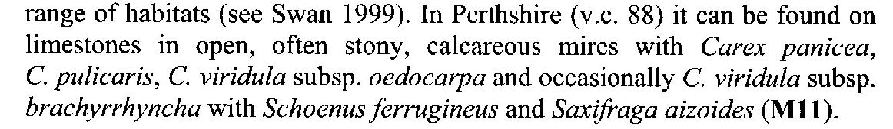
→
→
… calcareous habitats flagged in Sedges of the British Isles
(BSBI, 2007)

Slide 14
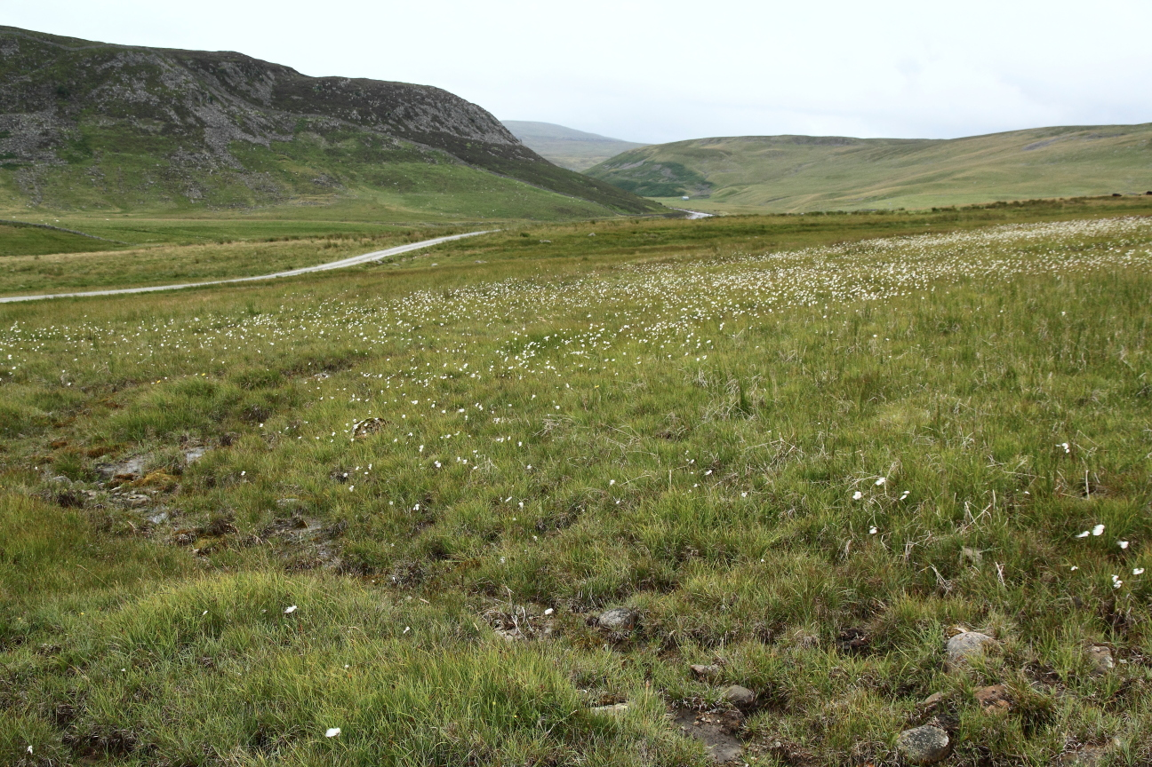
calcareous seepages,
Widdybank Pasture, Teesdale ~ 395 metres a.s.l.
T. cespitosum s.s.

Slide 15
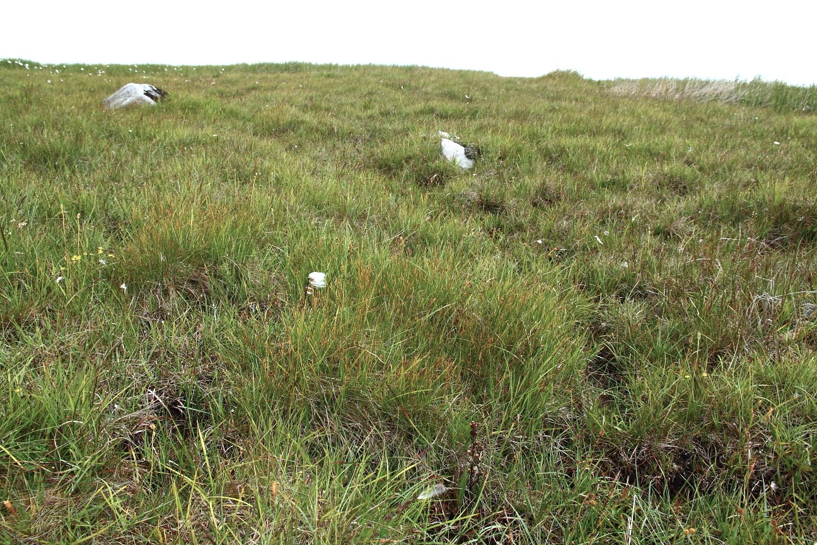
calcareous seepages:
Widdybank Pasture, Teesdale ~ 395 metres a.s.l.
T. cespitosum s.s.

Slide 16
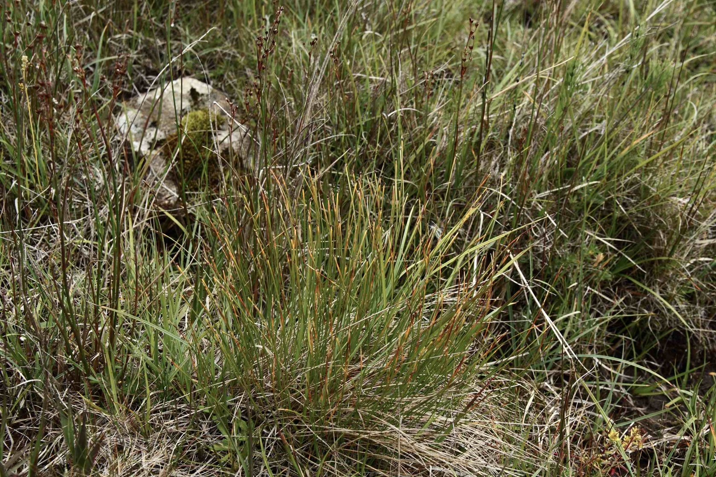
… here with Alpine Rush Juncus alpinoarticulatus
T. cespitosum s.s.

Slide 17
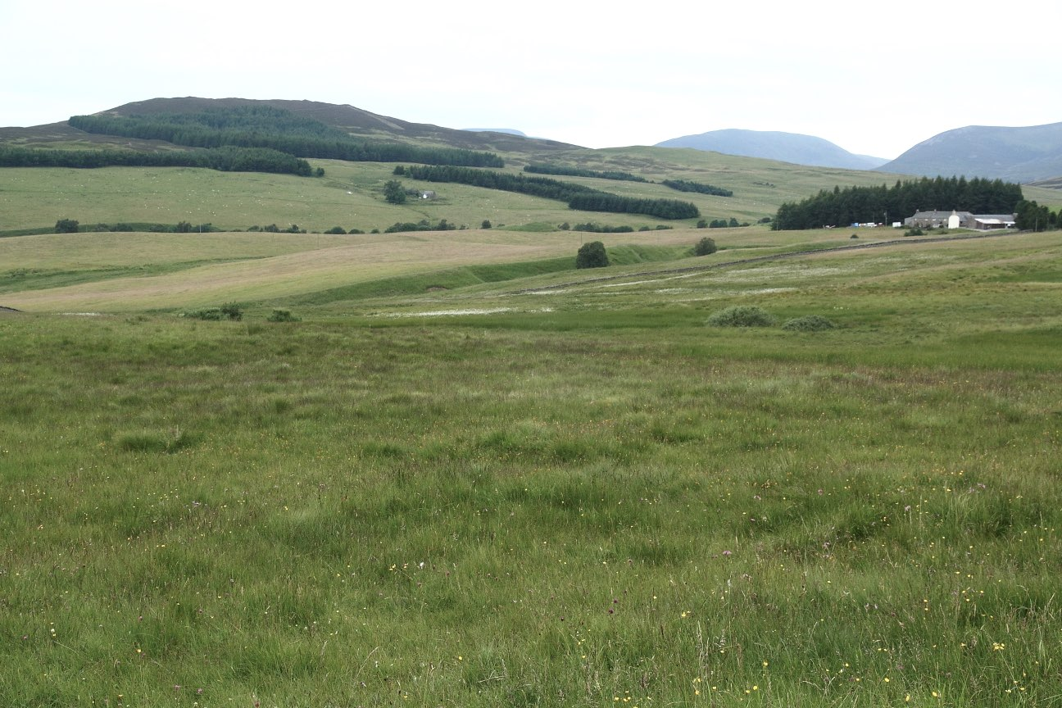
Glen Fender Meadows/Monzie – remarkably similar habitat to Widdybank Pasture …
T. cespitosum s.s.

Slide 18
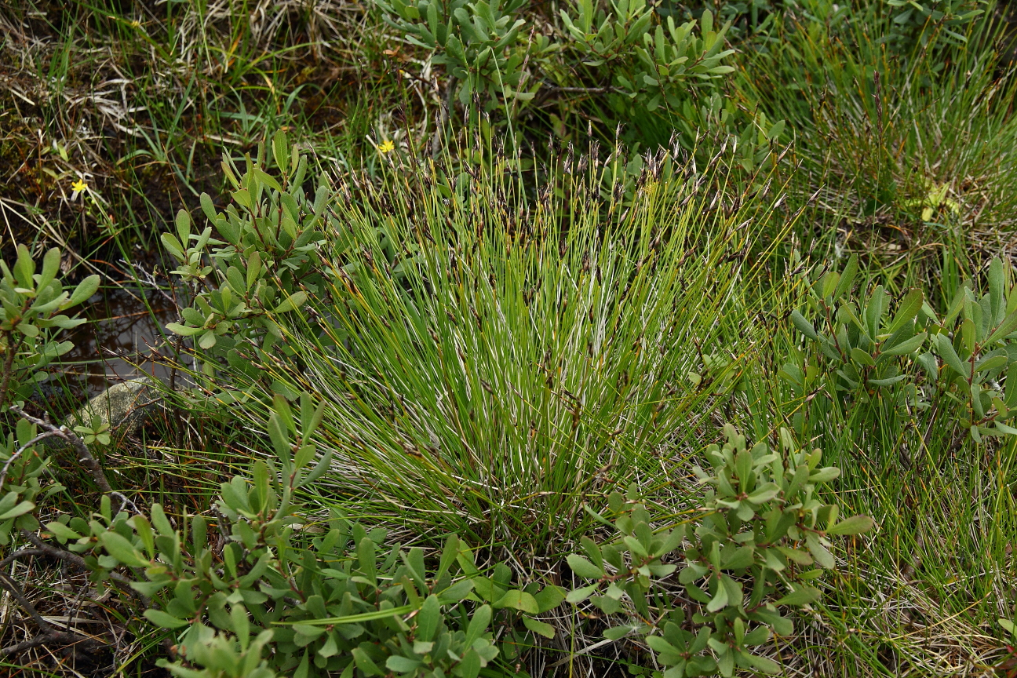
[… but occurs with (the yummy) Brown Bog-rush Schoenus ferrugineus]

Slide 19
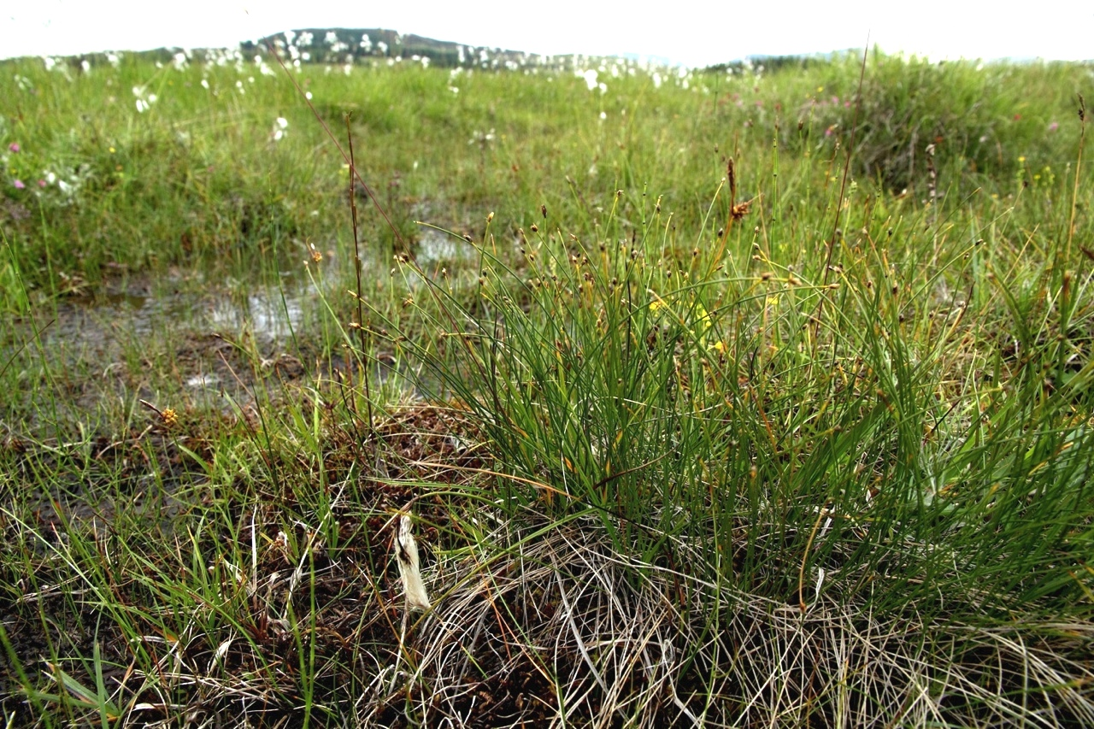
Trichophorum cespitosum
Glen Fender Meadows, with Triglochin, Saxifraga aizoides, etc.

Slide 20
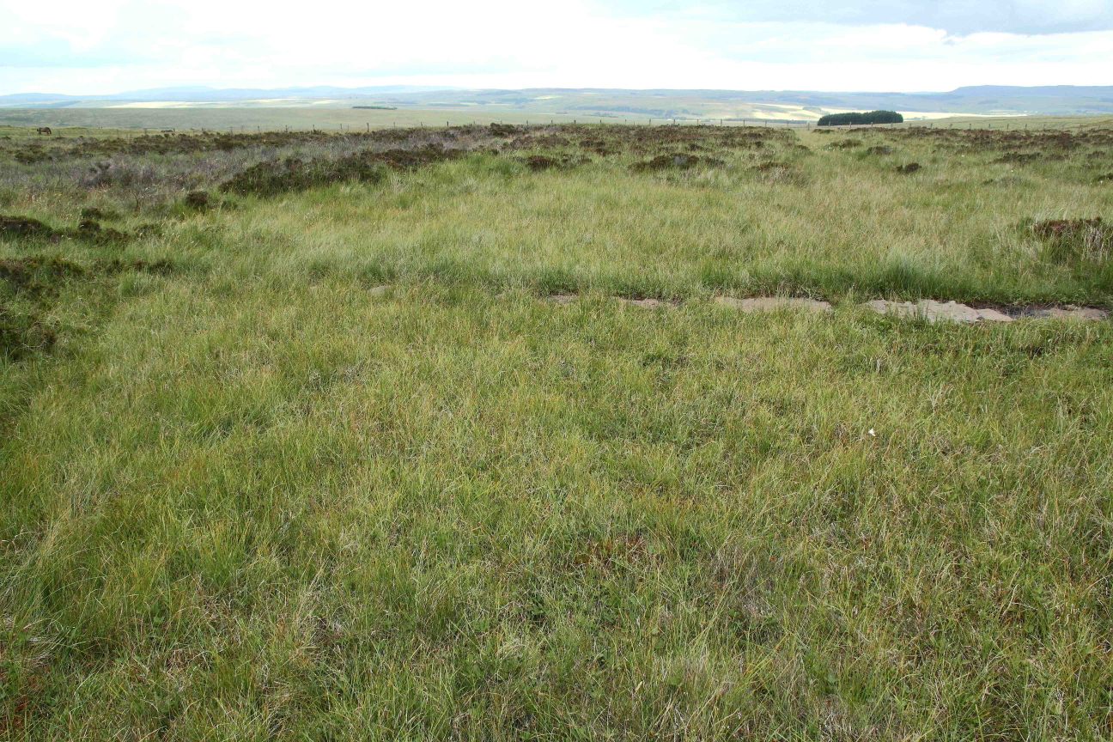
+++ Trichophorum cespitosum
calcareous seepages in blanket bog, Pennine Way at Chesters Burn Northumberland

Slide 21
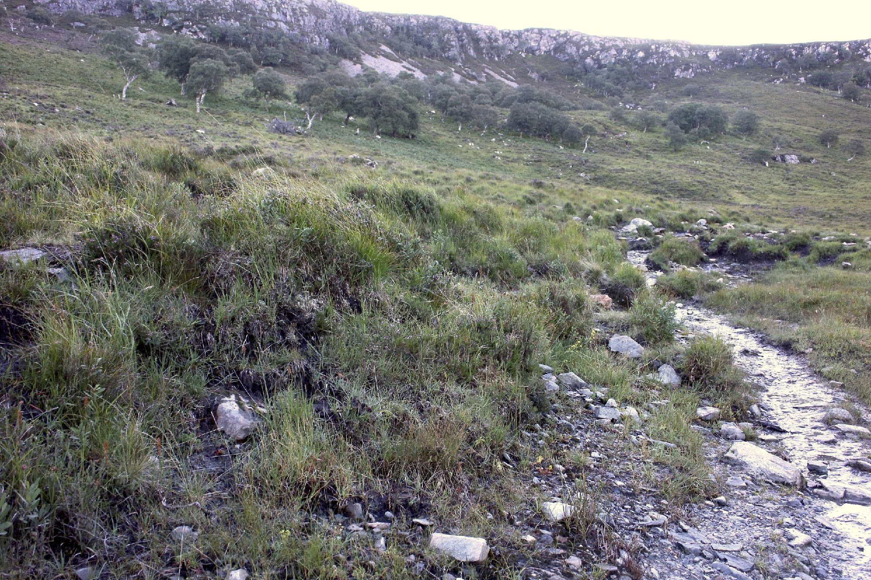
Trichophorum cespitosum
Allt Glean Chaorachain, An Teallach ~ 260 metres a.s.l.

Slide 22
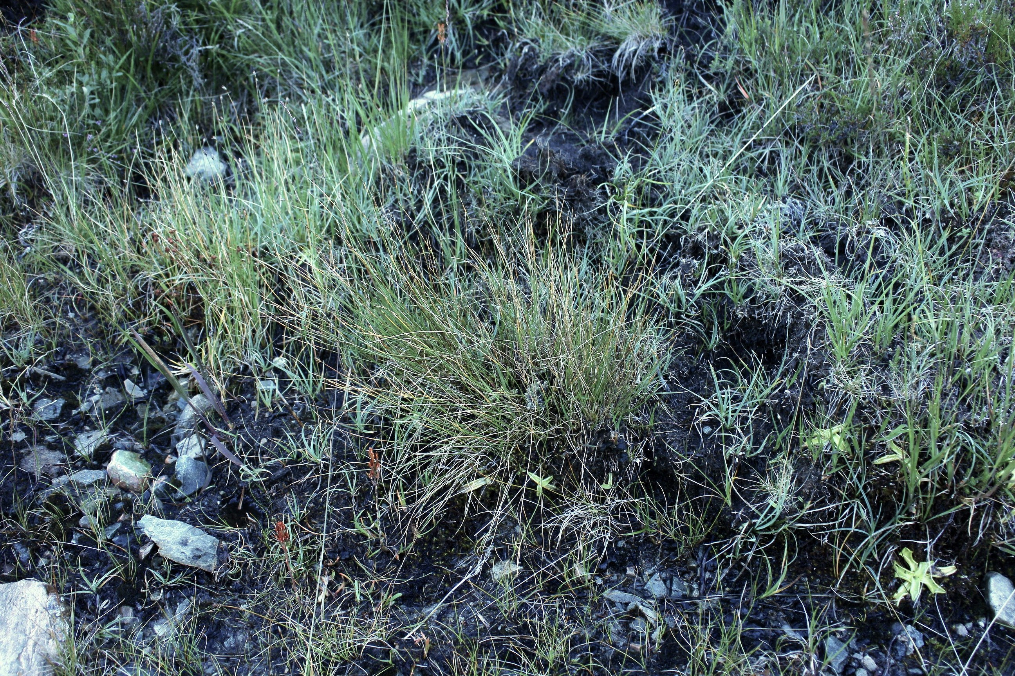
Trichophorum cespitosum
Allt Glean Chaorachain, An Teallach, with Pinguicula

Slide 23
Where to seek Northern Deergrass, Trichophorum cespitosum s.s.
Occurs in two very different habitats
2: ACIDIC

Slide 24
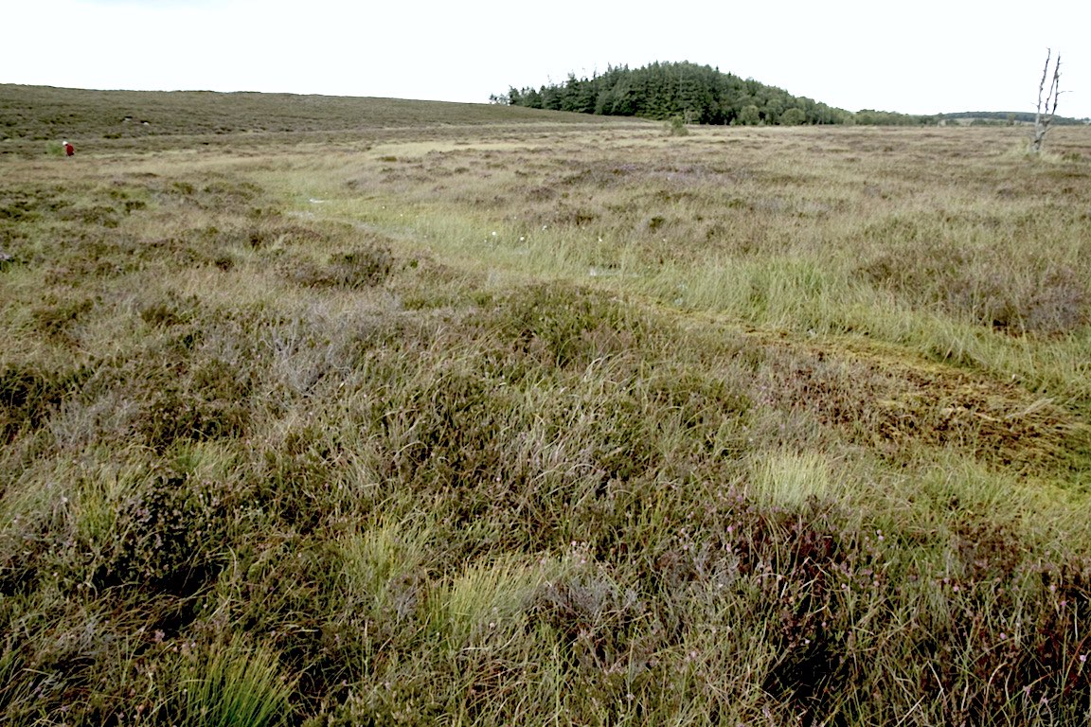
lagg zone inflows (slightly mineral-enriched) BUT also far out on quaking bog
Muckle Moss, Roman Wall, with abundant hybrid
T. cespitosum s.s.

Slide 25
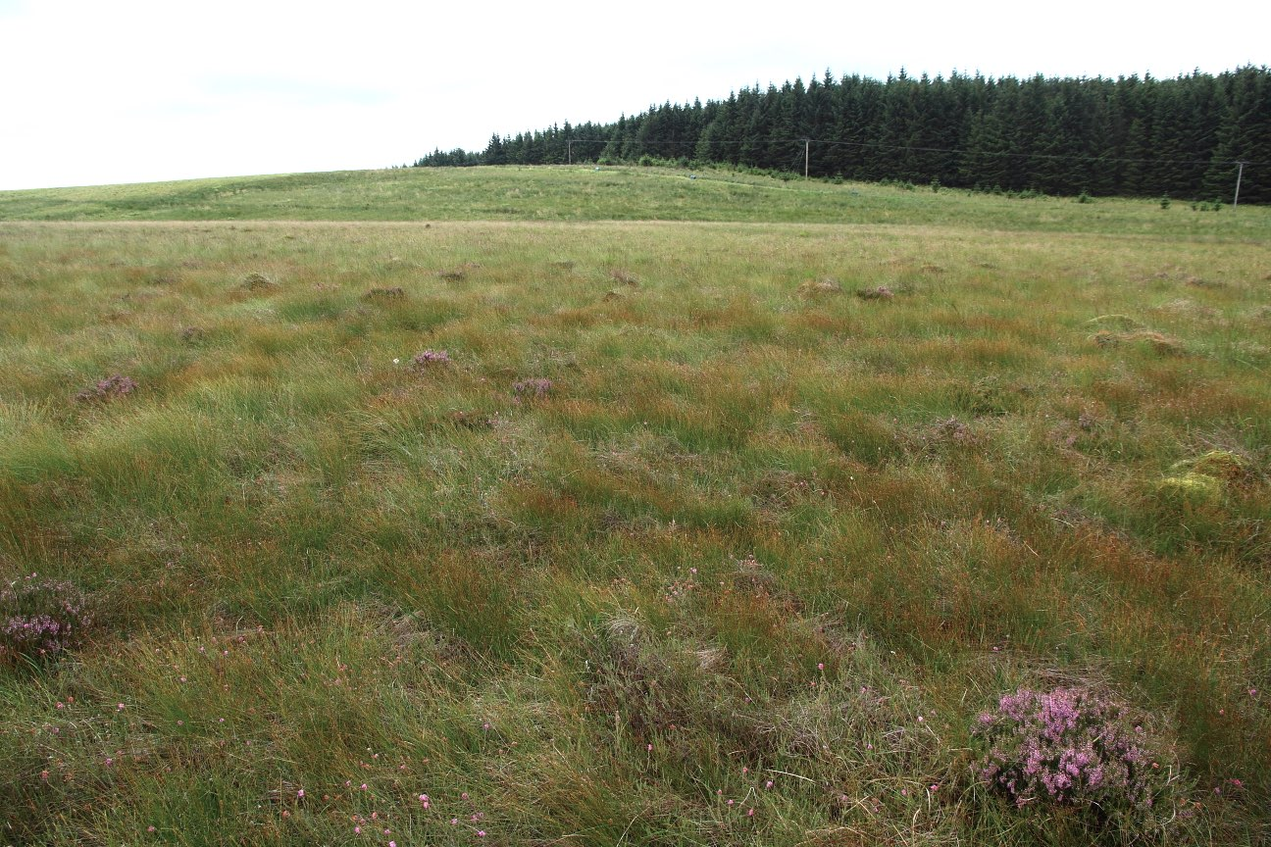
basin- and raised-mires
Cumbria/Northumberland
T. × foersteri here dominating on peat-surface…

Slide 26
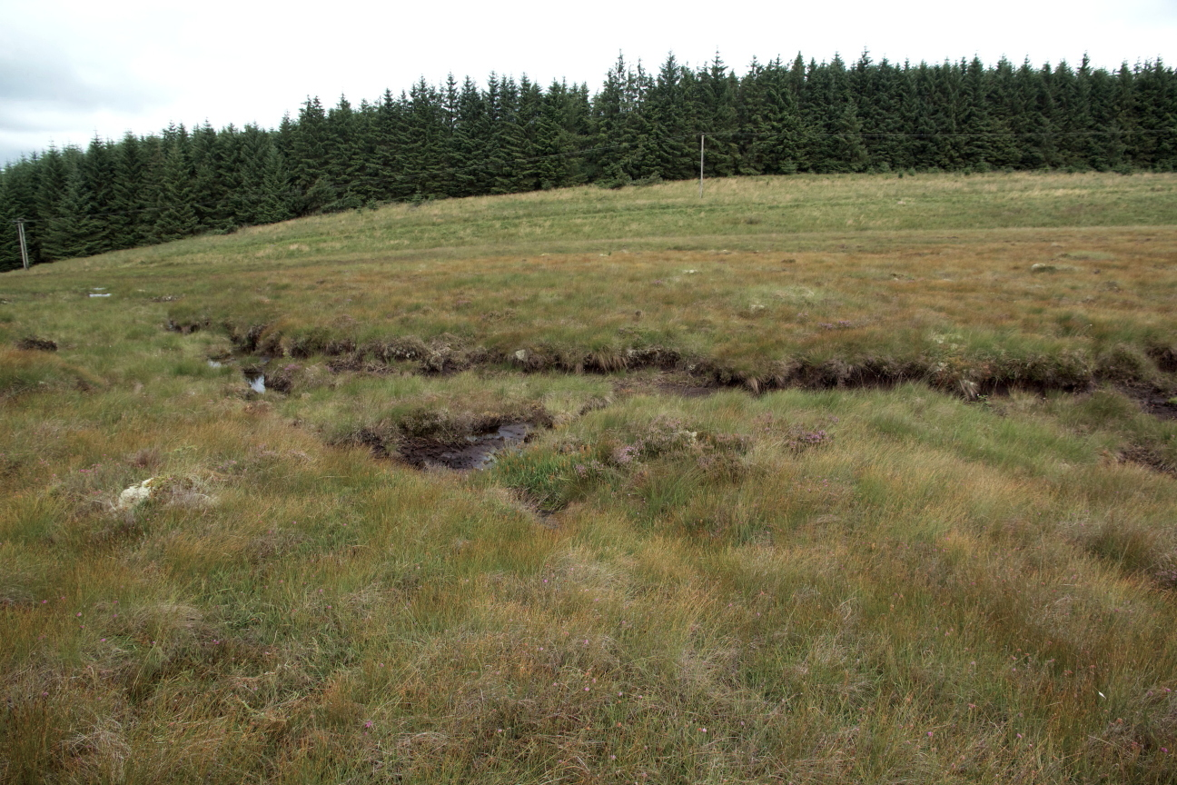
basin- and raised-mires
Cumbria/Northumberland
T. × foersteri dominating on peat-surface, with…

Slide 27
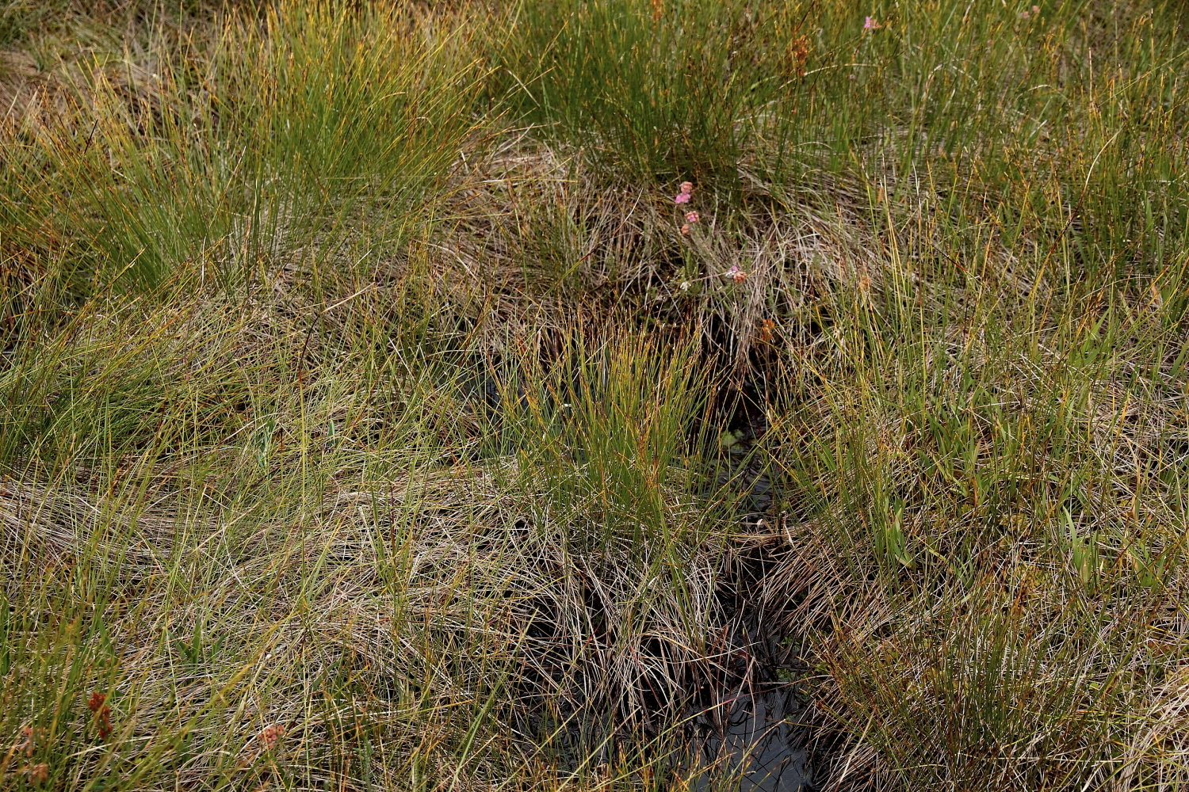
basin- and raised-mires
Cumbria/Northumberland
… T. cespitosum typically down in runnels/seepages, taller hybrid above

Slide 28
T. cespitosum logged along a route over Butterburn Flow, most frequent on the deepest peat lobes
[estimated population over whole 410 hectare site: 100,000 plants!]
Northumberland
R. Irthing
Cumberland
4.8 km track
~ 217 plants
[hurrying home: no searching!]
Spadeadam Forest
Notes:
Pale areas are dominant Molinia - Purple Moor-grass - absent from there. Speeded up on way back - perhaps missed it?

Slide 29
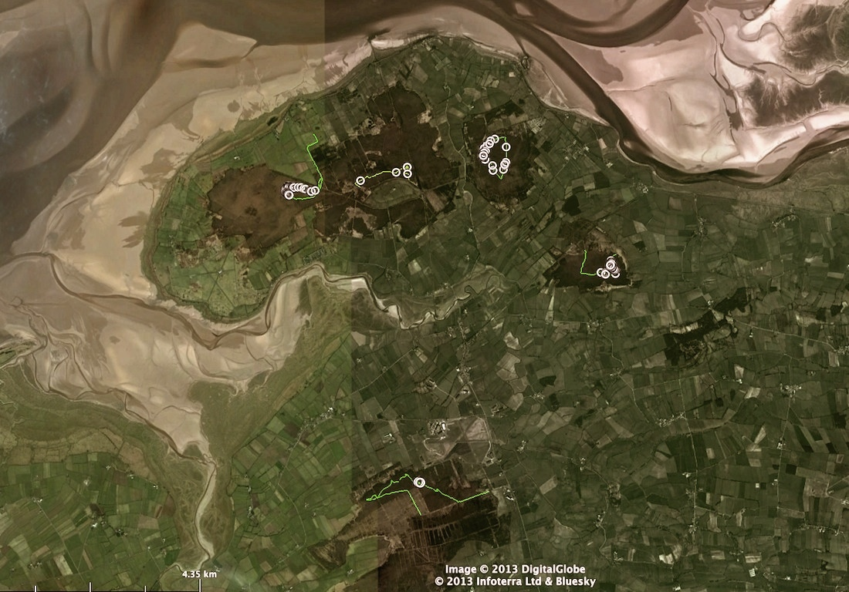
T. cespitosum
~ eventually found on all South Solway Mosses raised mires in N. Cumbria ~ 10–15 metres a.s.l.
Glasson Moss
Bowness Common West and East
Drumburgh Moss
Wedholme Flow
Notes:
In all the remaining +/- “intact” mires near sea-level

Slide 30
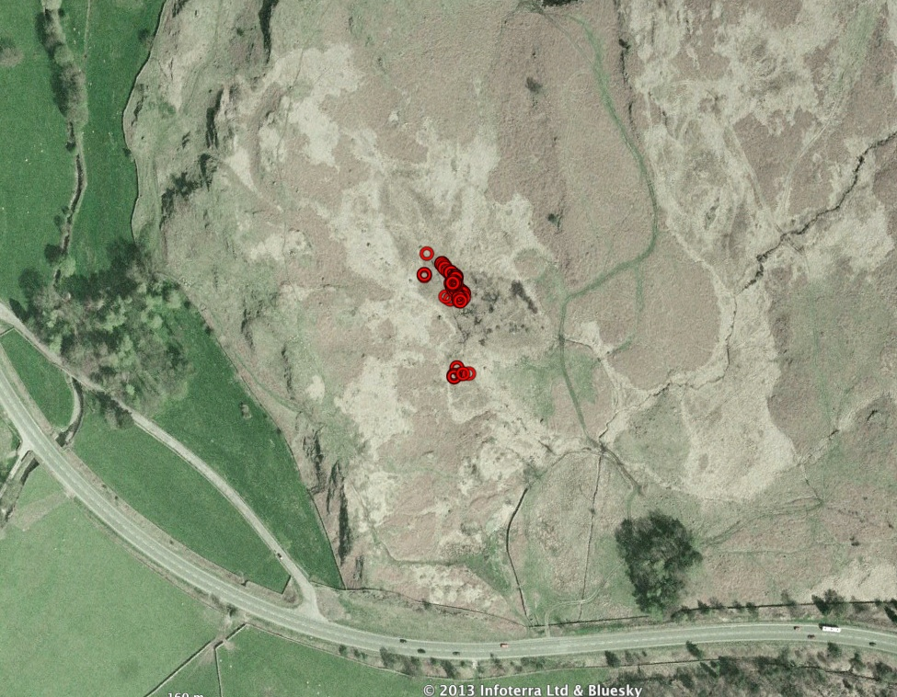
T. cespitosum
High Rigg, Thirlmere, central Lake District
~ 170 metres a.s.l.
Notes:
A 591 - Rough How Bridge, S end of High Rigg - one of just TWO sites discovered SO FAR in the Lake District.

Slide 31
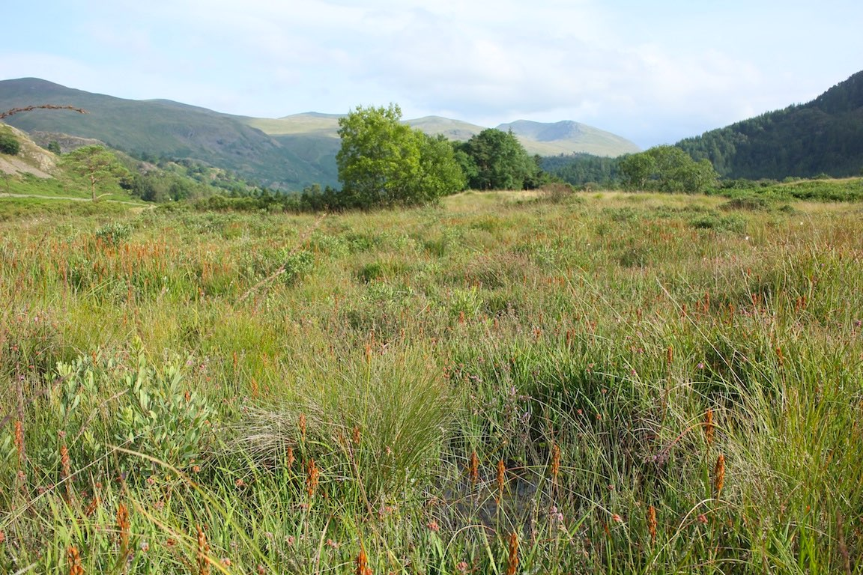
High Rigg, above Thirlmere, Lake District ~ 170 metres a.s.l.
emergent from bog-pools and seepages
Notes:
usual associates - but actually emergent from bog pools.

Slide 32
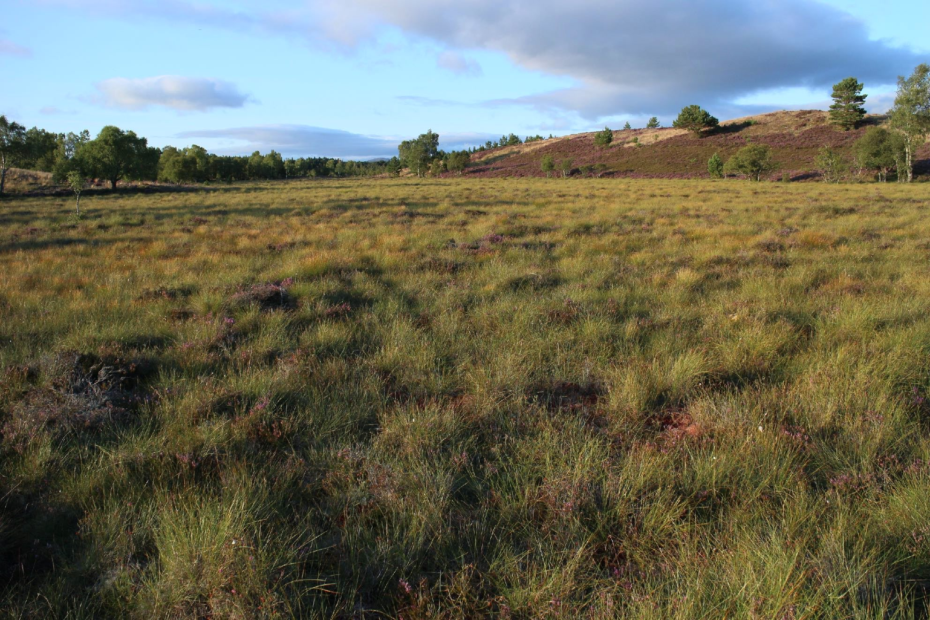
Tulloch Moor, Spey ~ 220 metres a.s.l. (an Andy Amphlett site)
T. × foersteri dominant, with T. cespitosum occuring in runnels and sphagnum lawns

Slide 33
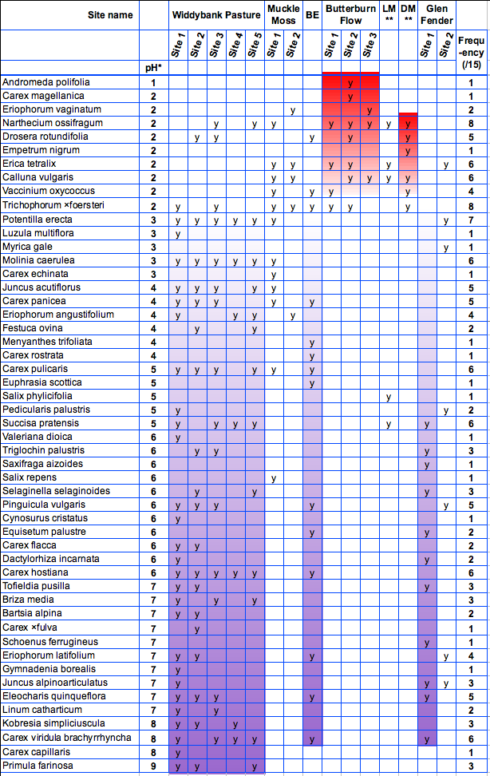
T. cespitosum s.s.
acid and basic habitats
(NB: see website version, with keys)
shows remarkable divergence of associates in basic versus acidic sites
huge number of associates in basic sites, but very few in acidic sites!

Slide 34
Trichophorum cespitosum s.s.
the same divergent habitat preferences can be seen on the continent …
1 BASIC:
Notes:
THREE species - TWO dealt with SUPERFICIALLY - ONE even more superficially...

Slide 35
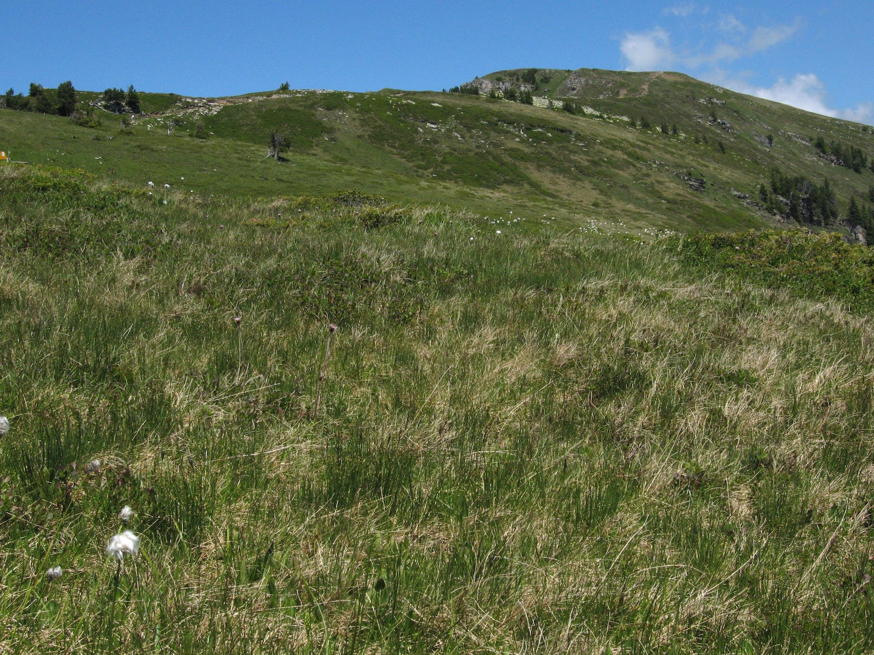
Niederhorn, Switzerland
seepages in damp heath
over limestone ~ 2000 m
T. cespitosum with Homogyne alpina and Eriophorum scheuchzeri

Slide 36
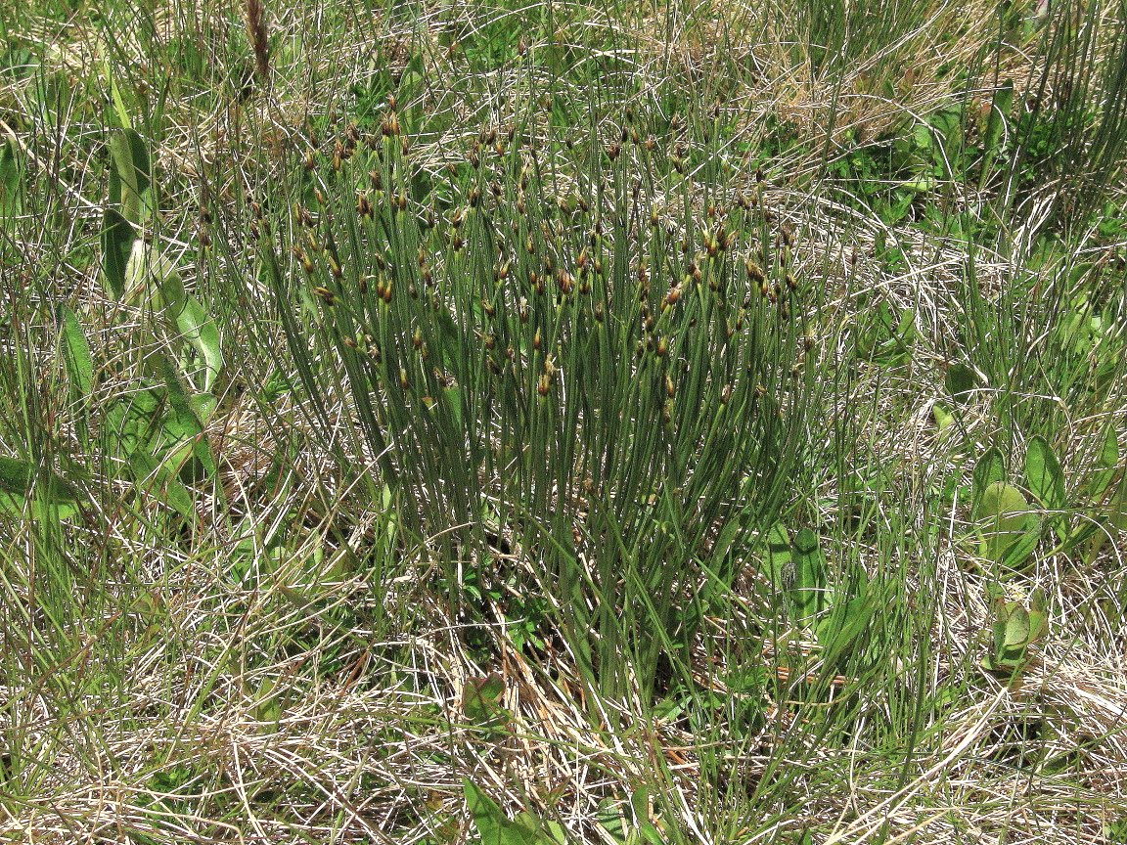
T. cespitosum

Slide 37
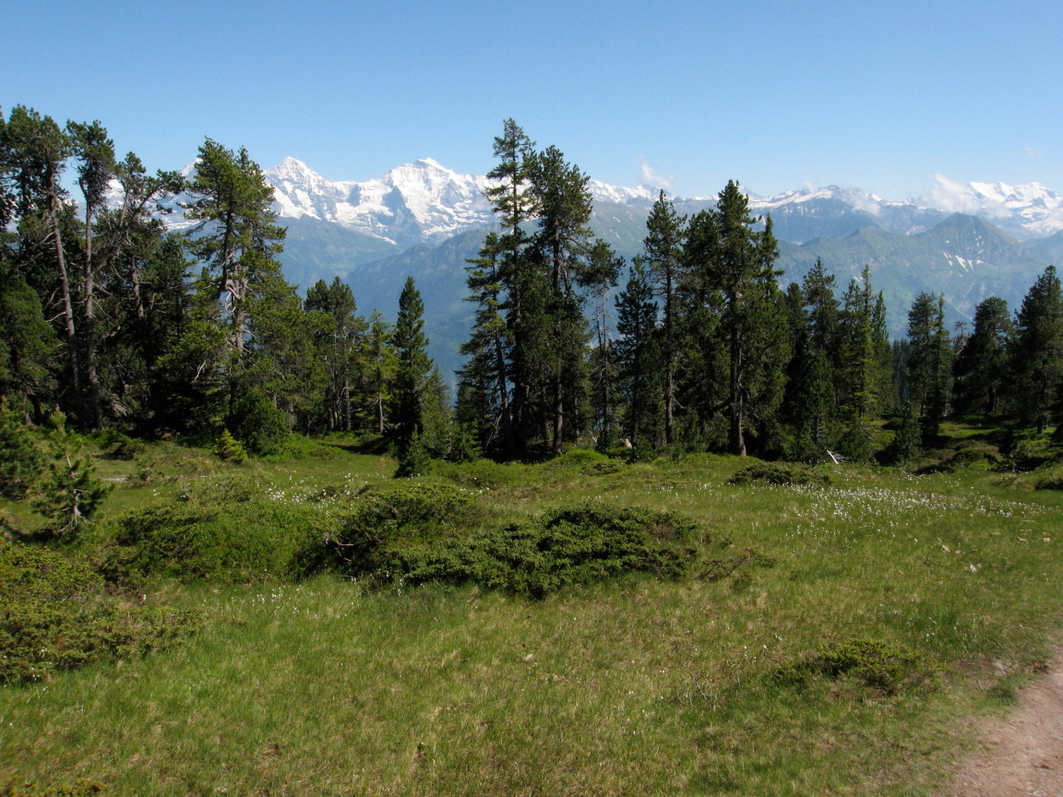
also lower, in forest clearings, ~ 1635 m
T. cespitosum

Slide 38
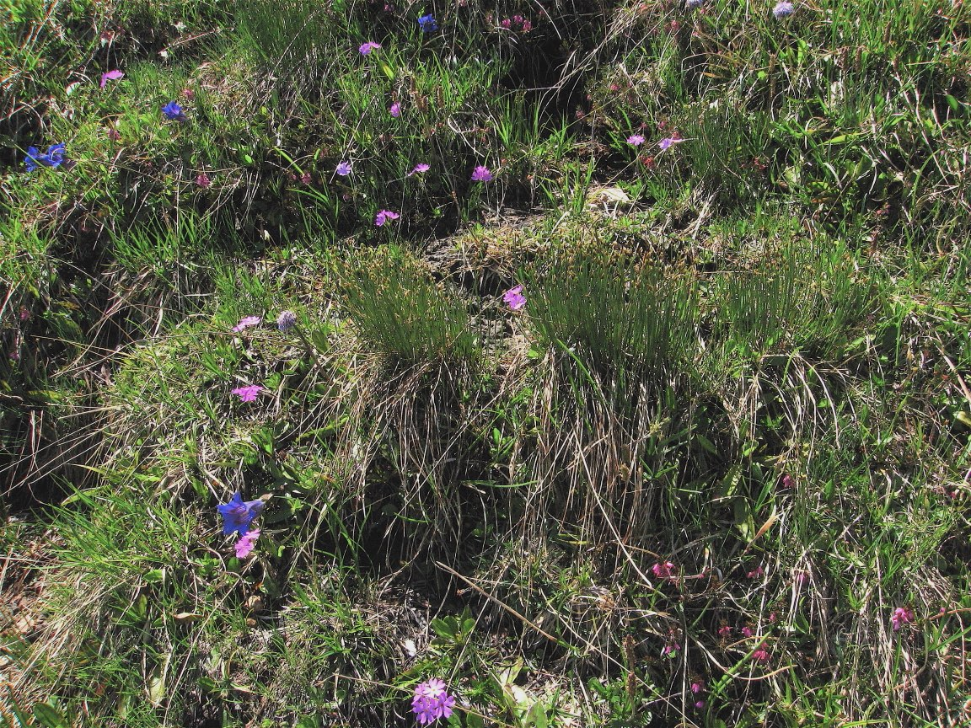
with Primula and Gentiana
T. cespitosum

Slide 39
Trichophorum cespitosum s.s.
the same divergent habitat preferences can be seen on the continent …
2 ACIDIC:
Notes:
THREE species - TWO dealt with SUPERFICIALLY - ONE even more superficially...

Slide 40
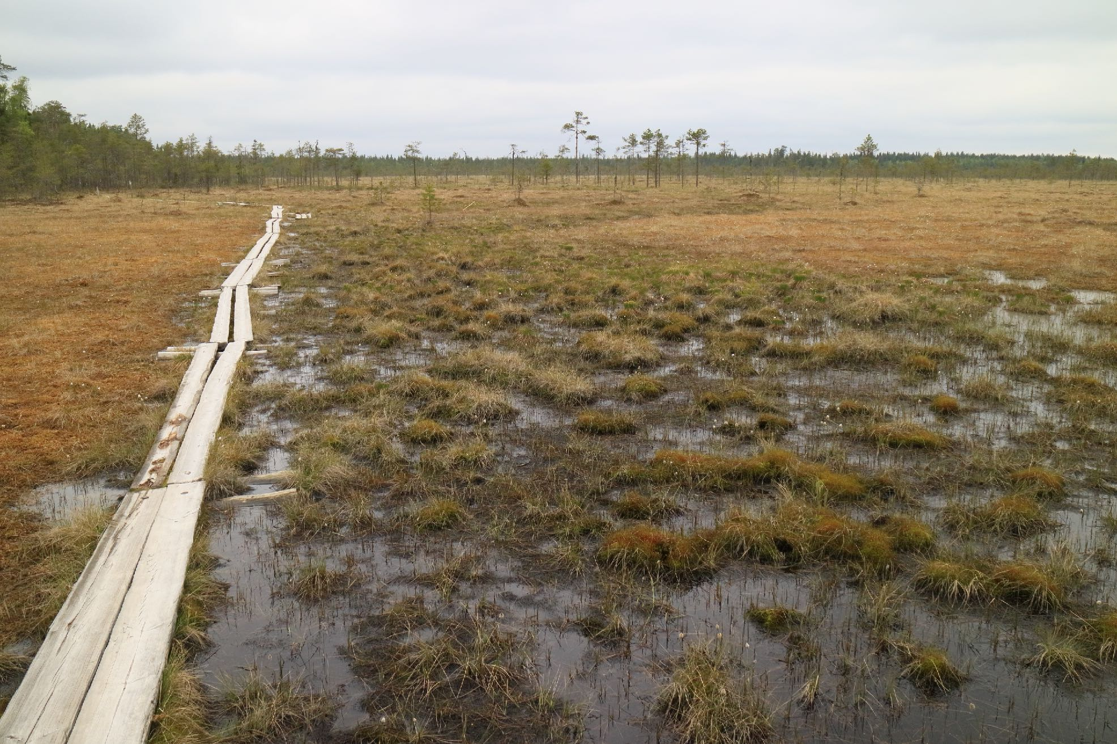
raised mire
NC Finland
T. cespitosum

Slide 41
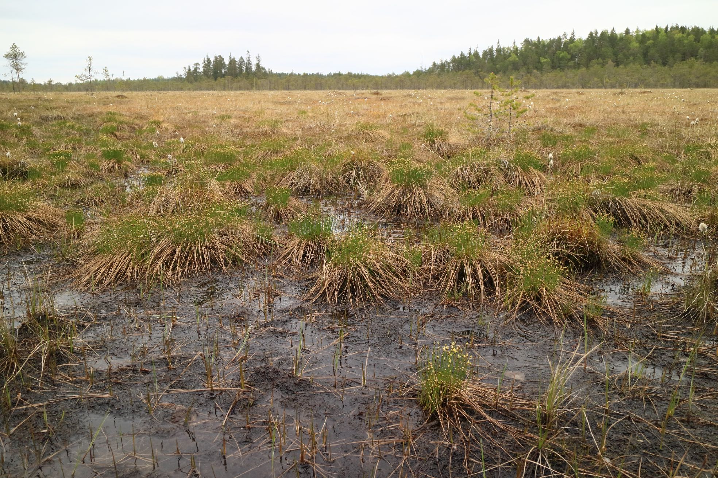
T. cespitosum

Slide 42
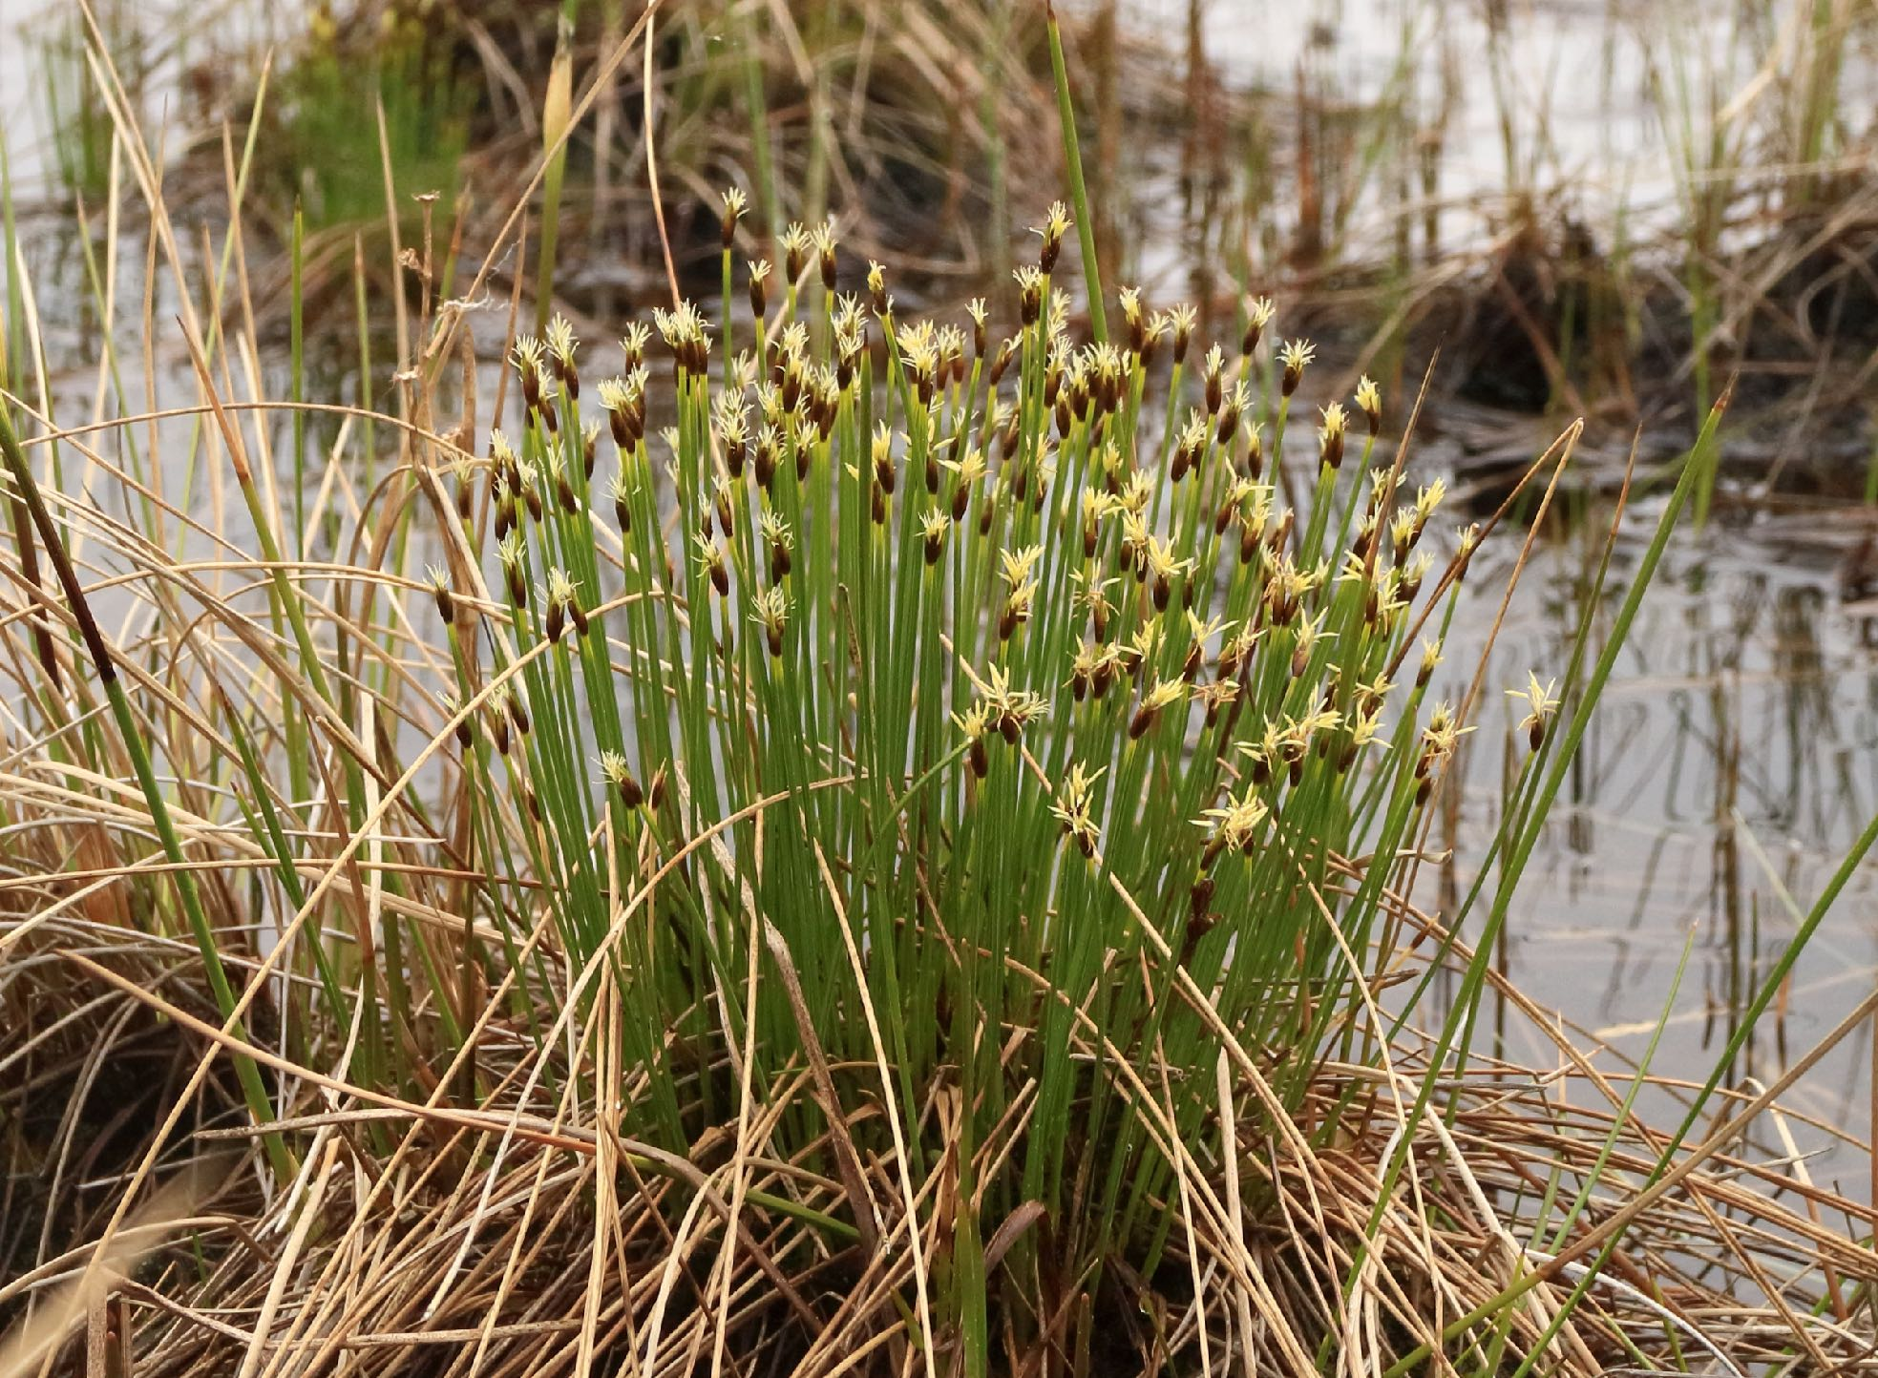
T. cespitosum

Slide 43
Separation & identification:
1
Fertile or sterile?

Slide 44
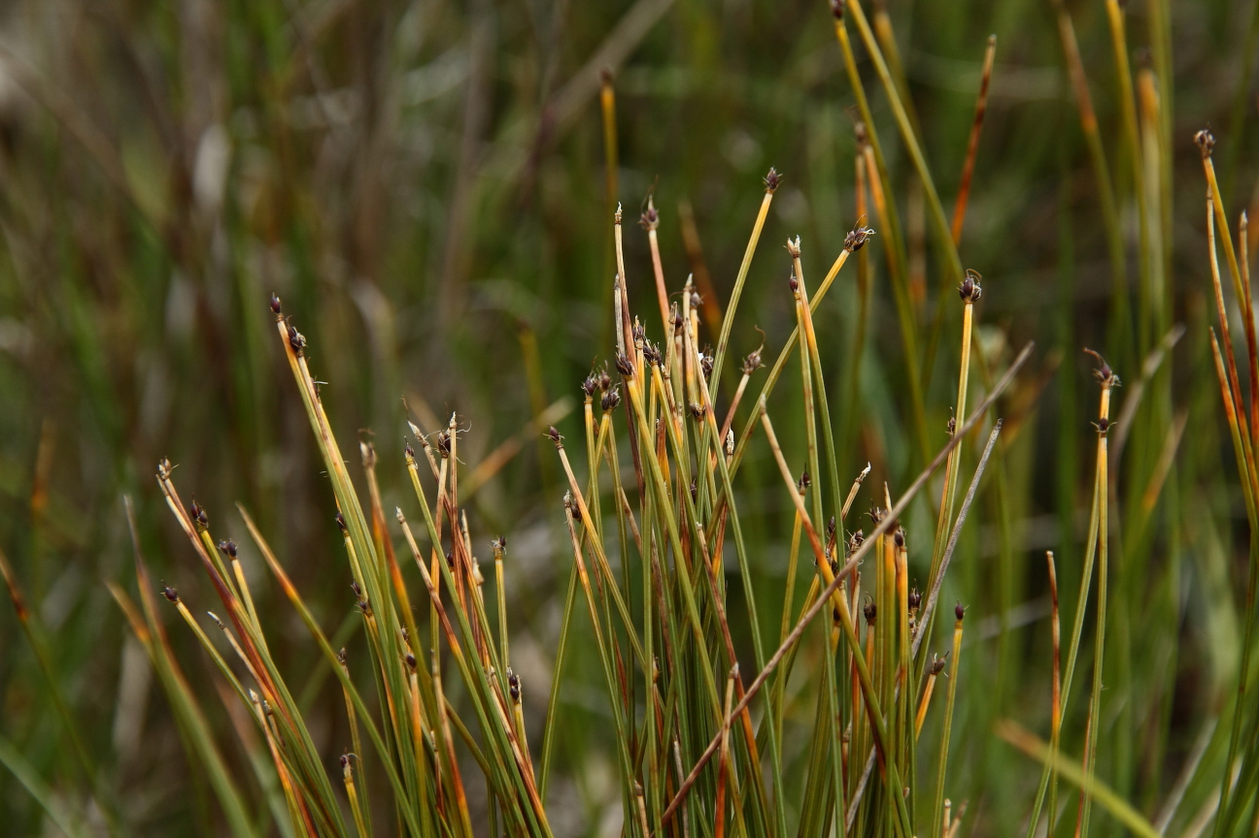
First question: EITHER, 1) Has it got RIPE fruit?
(… here and in next three slides)

Slide 45
If RIPE, then it’s one or other SPECIES, and NOT the sterile hybrid!

Slide 46
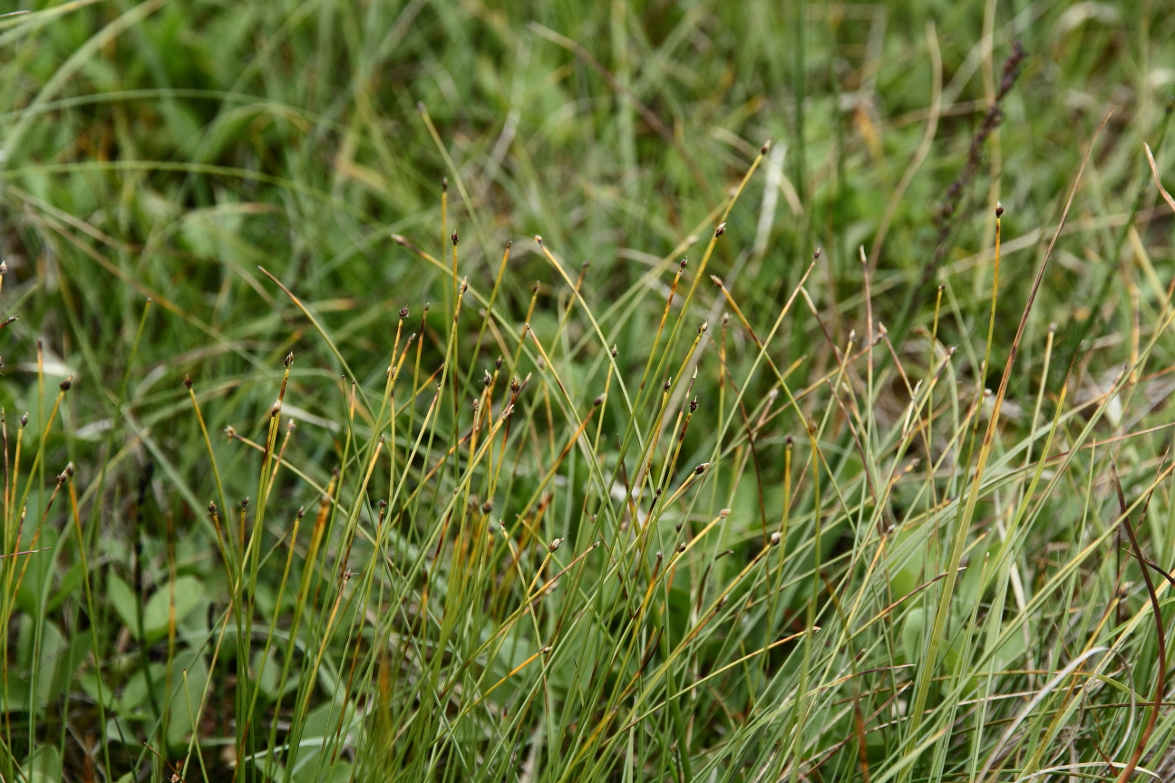
but in the field, nuts are often very inconspicuous in T. cespitosum …

Slide 47
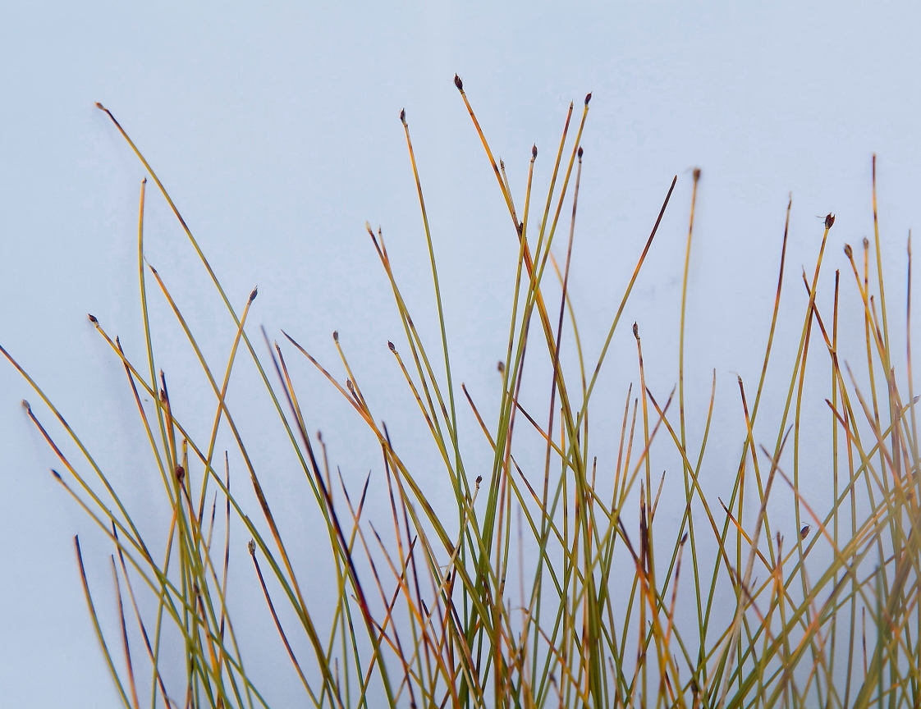
… without a pale background to show them up!
… in T. cespitosum, ‘like 1 or 2 black fleas!’

Slide 48
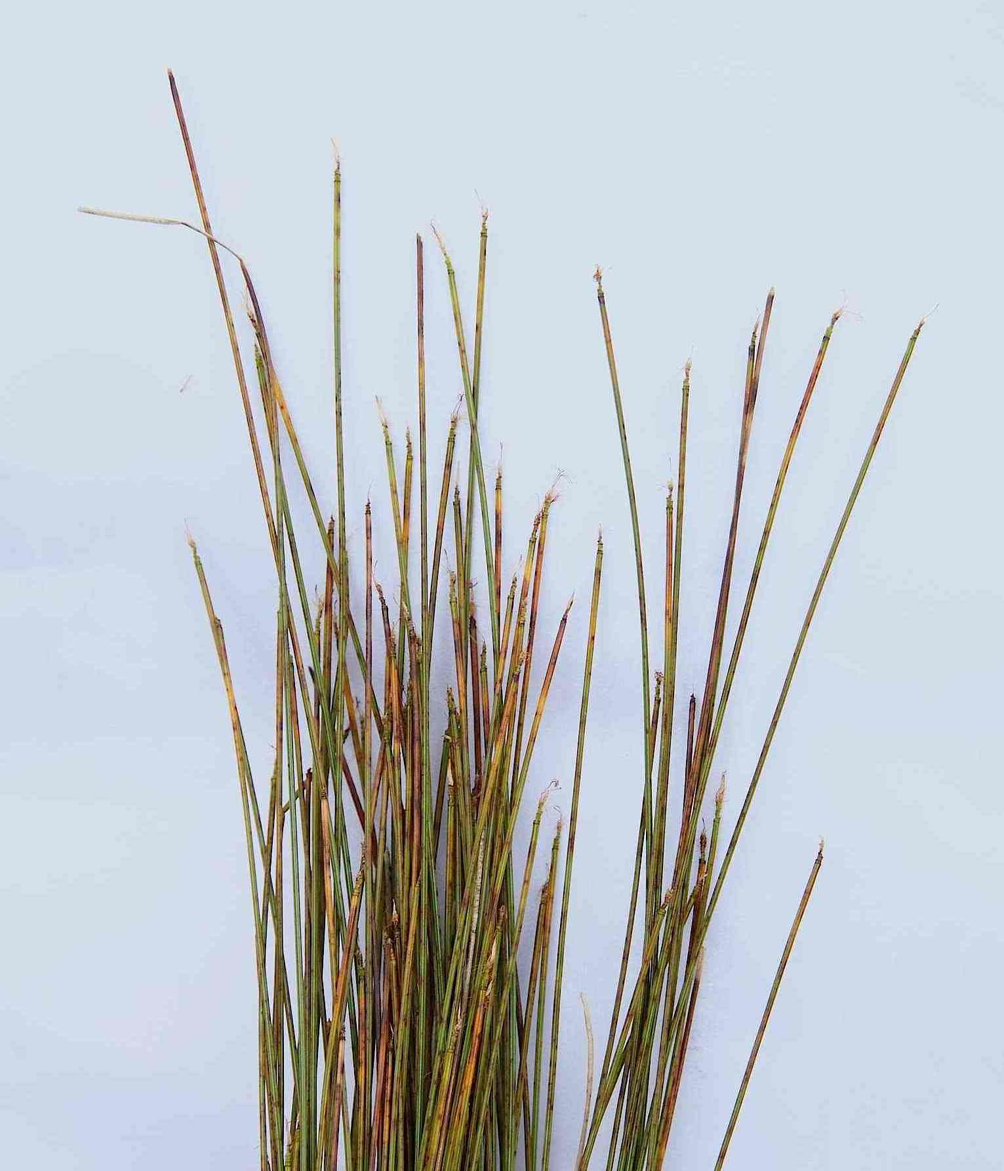
OR:
2) has it got ‘BARE TOPS’ from mid-July?
Then it’s EITHER the hybrid, OR perhaps aborted example of the species
T. × foersteri

Slide 49
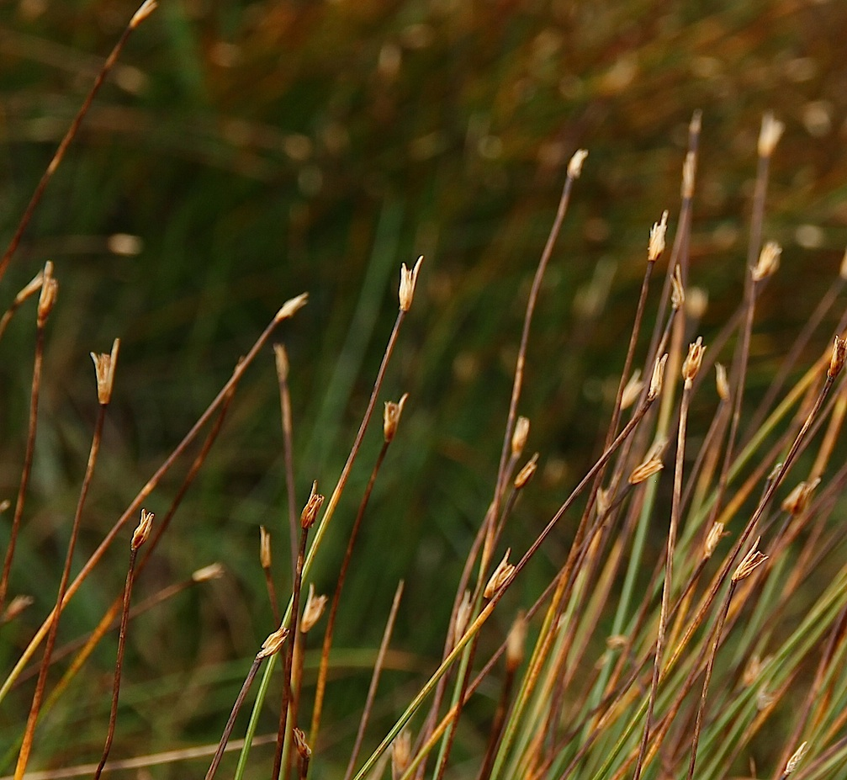
[If it is germanicum with aborted fruits, the spikelets MAY retain the glumes for much longer than the hybrid, as here…]
T. germanicum

Slide 50
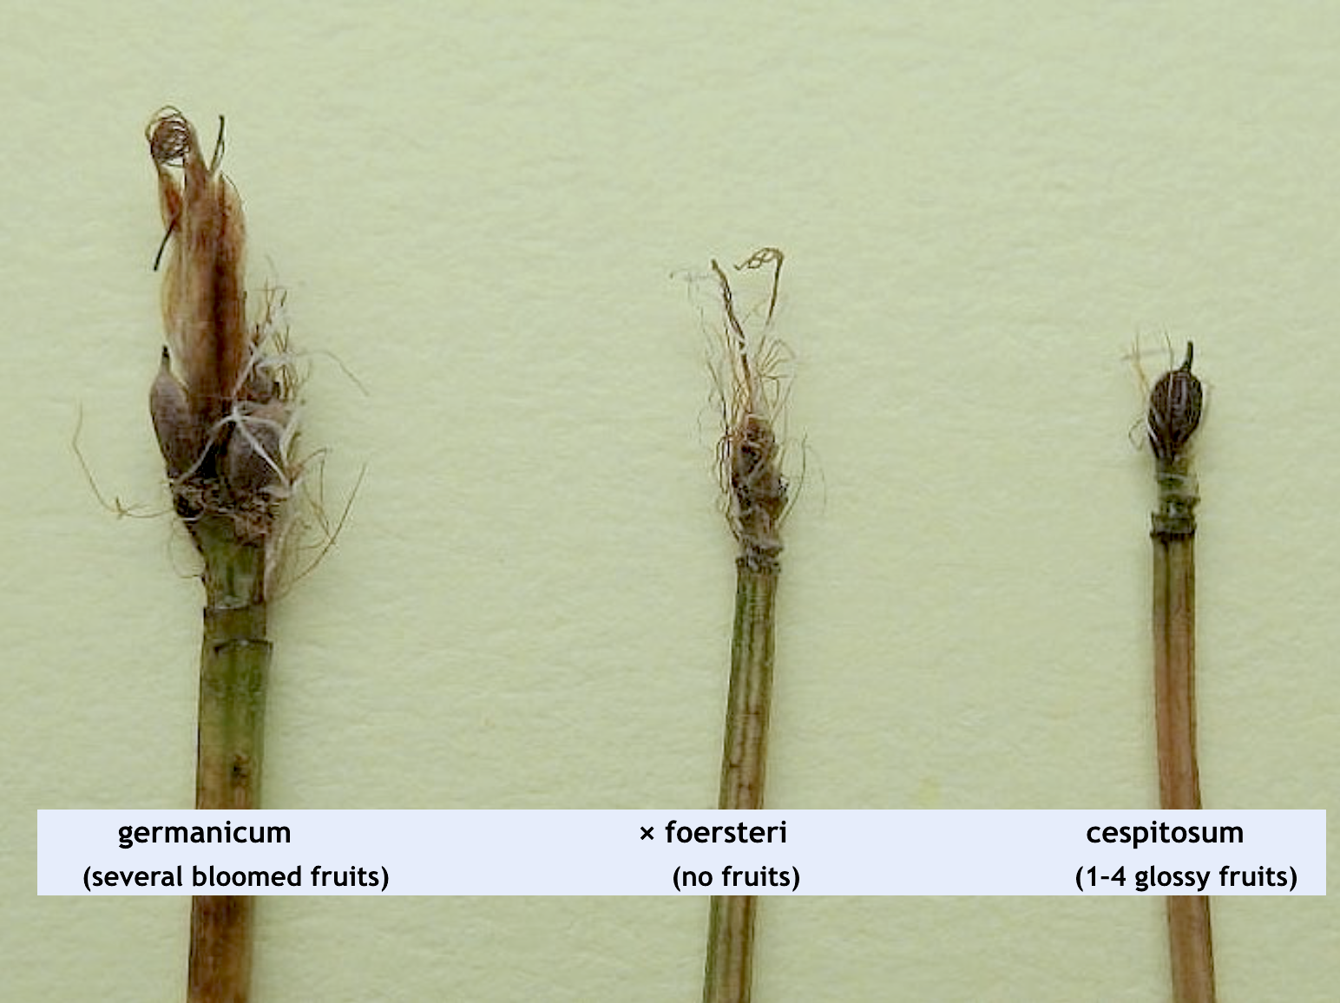
When fully ripe:

Slide 51
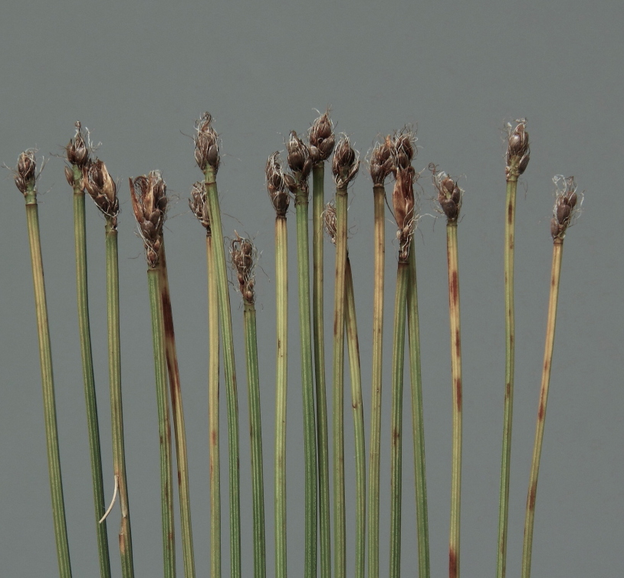
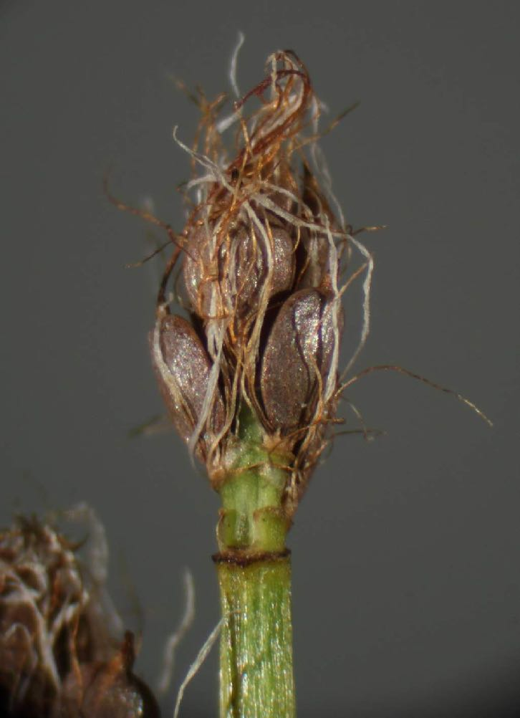
germanicum
tight cluster of bloomed fruits

Slide 52
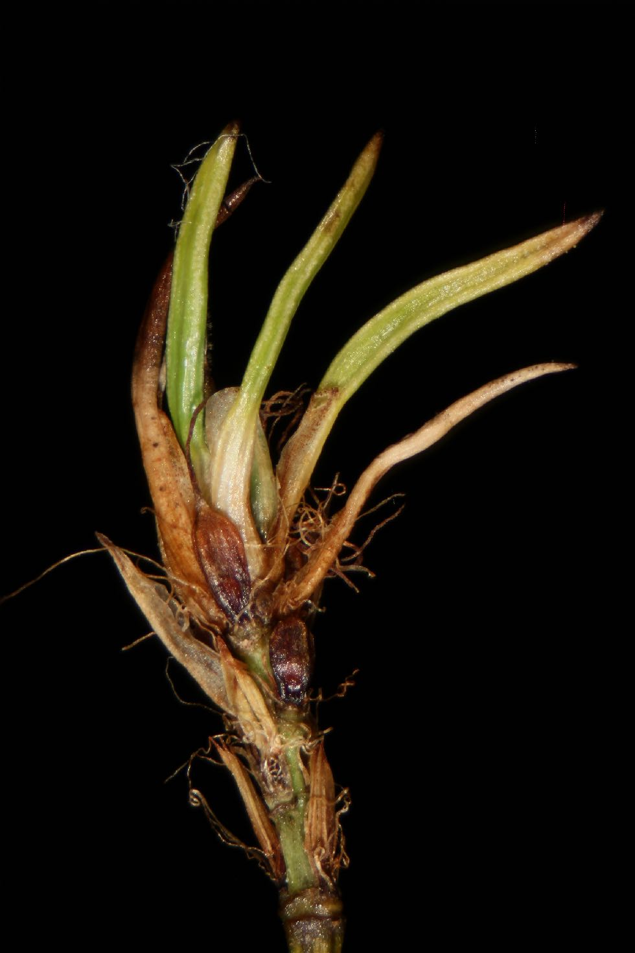
NOTE:
germanicum and
× foersteri heads can be PROLIFEROUS
(prolifery is NOT seen in cespitosum)
… note this germanicum also has some ripening fruits (arrowed)

Slide 53
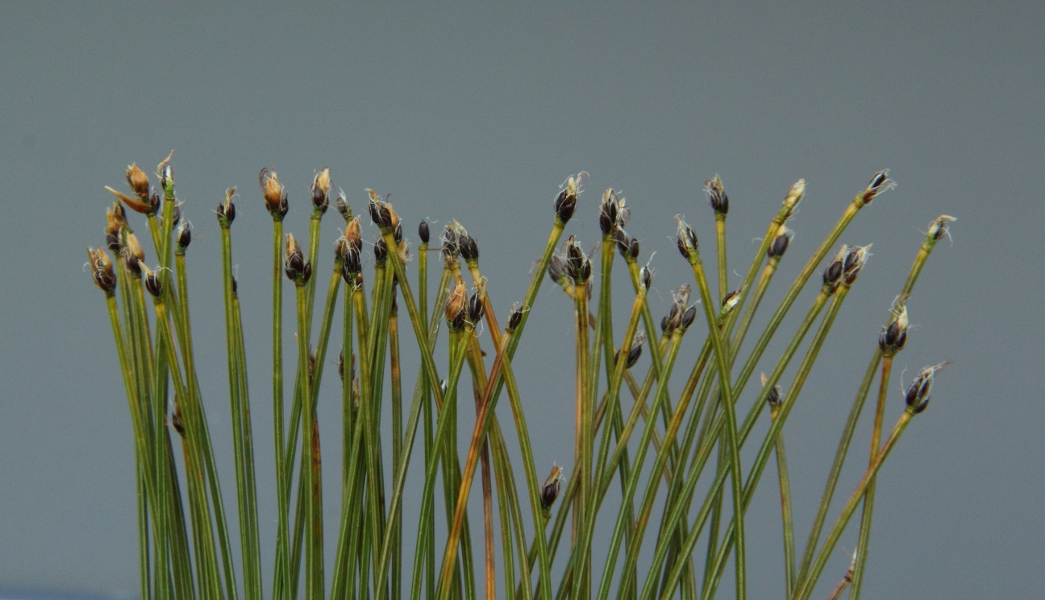
cespitosum
small heads with just a few shiny fruits
(rarely seen in such good fruit!)

Slide 54
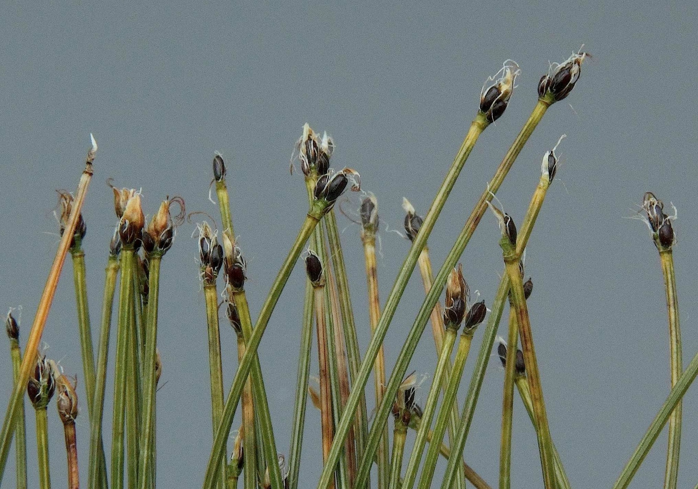
cespitosum

Slide 55
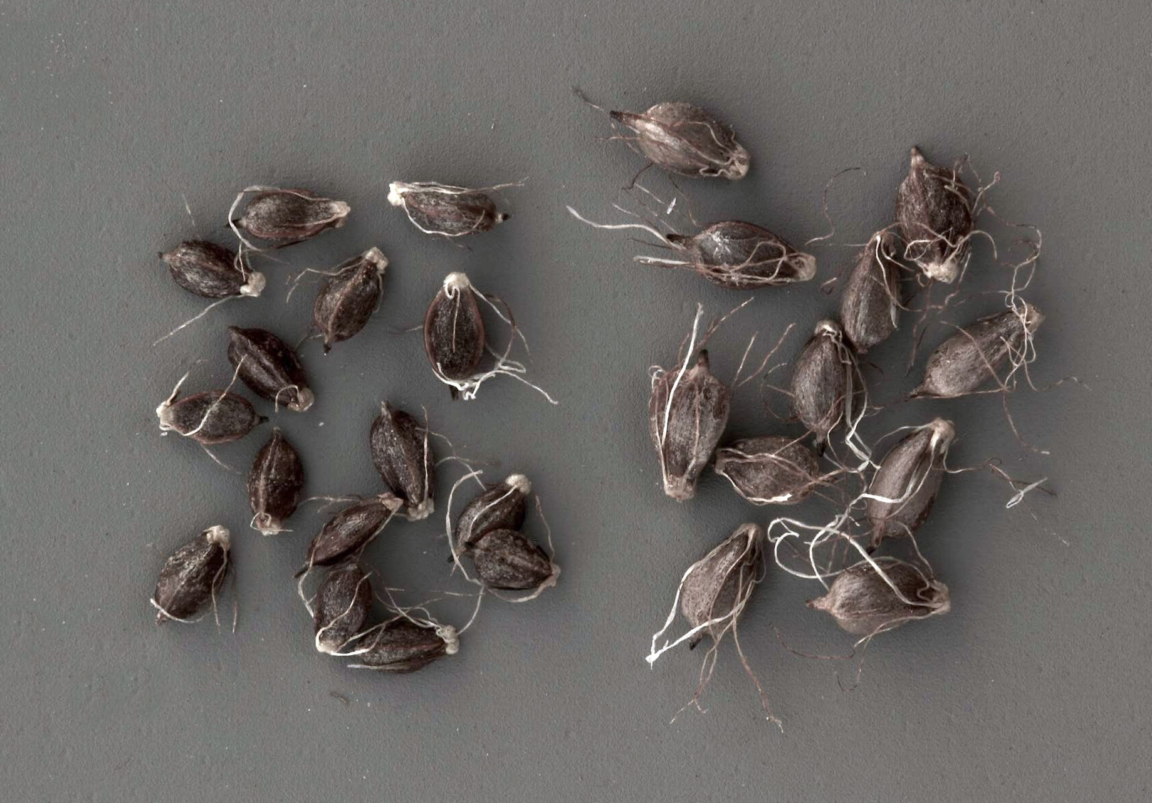
cespitosum germanicum

Slide 56
Separation & Identification:
2
Upper sheath-opening
& stem-width

Slide 57
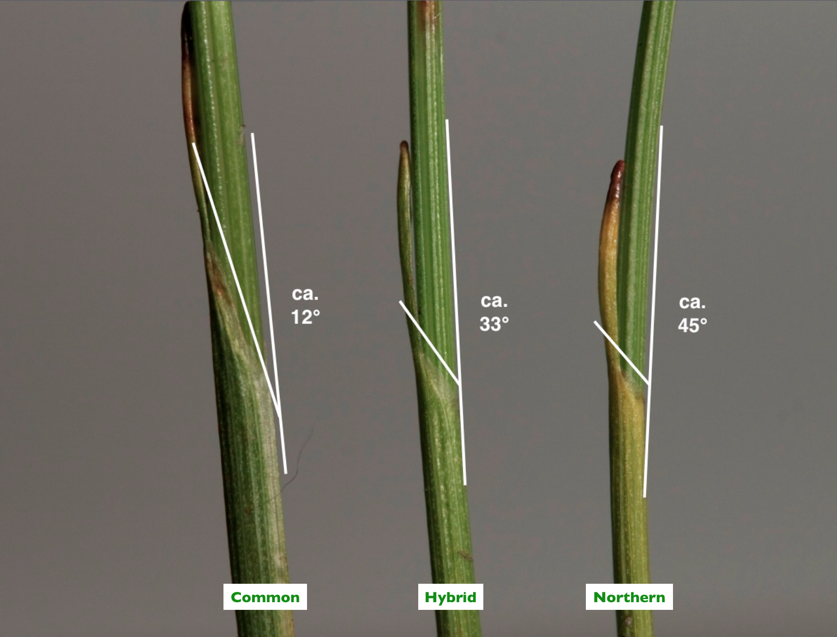
ANGLE of sheath-opening
[In these particular examples]
germanicum × foersteri cespitosum
(STRONGLY oblique) (oblique; variable) (can be +/– transverse, i.e. 90º)
Common
Hybrid
Northern

Slide 58
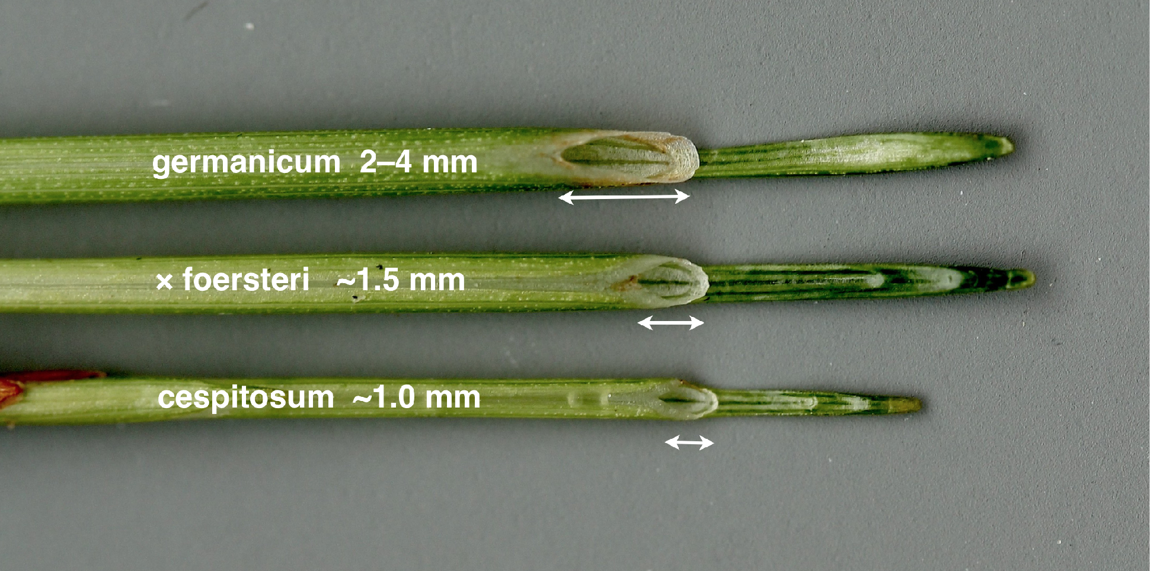
LENGTH of sheath-opening
Easier to measure: snap stem an inch below the opening, and (try to) pull out stem to leave sheath-opening
a crucial character!

Slide 59
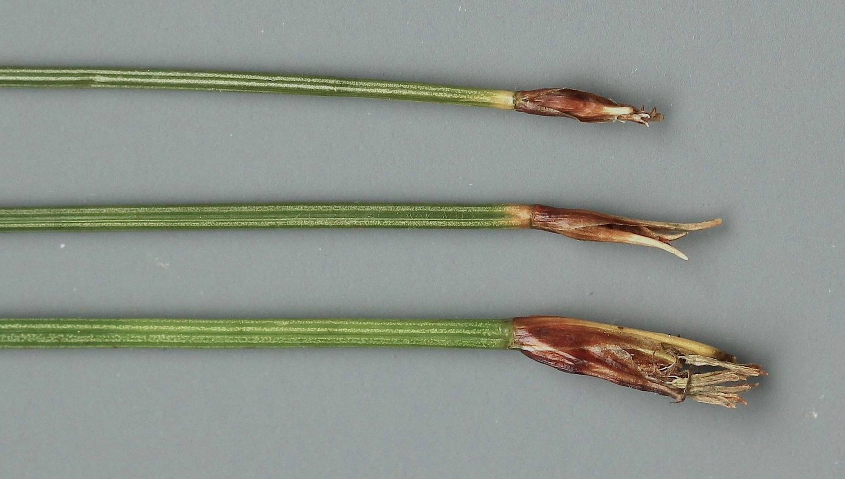
Stem WIDTHS
Spikelet size
& no. of flowers
cespitosum
(0.45–)0.5–0.6(–0.7) mm
always short
never expands, and glumes soon dropped
× foersteri
0.7–0.85 mm
germanicum
typically = 1mm
(can be 0.6mm!)
large and swells, if ripening
[length of basal glumes might be worth exploring as a character]

Slide 60
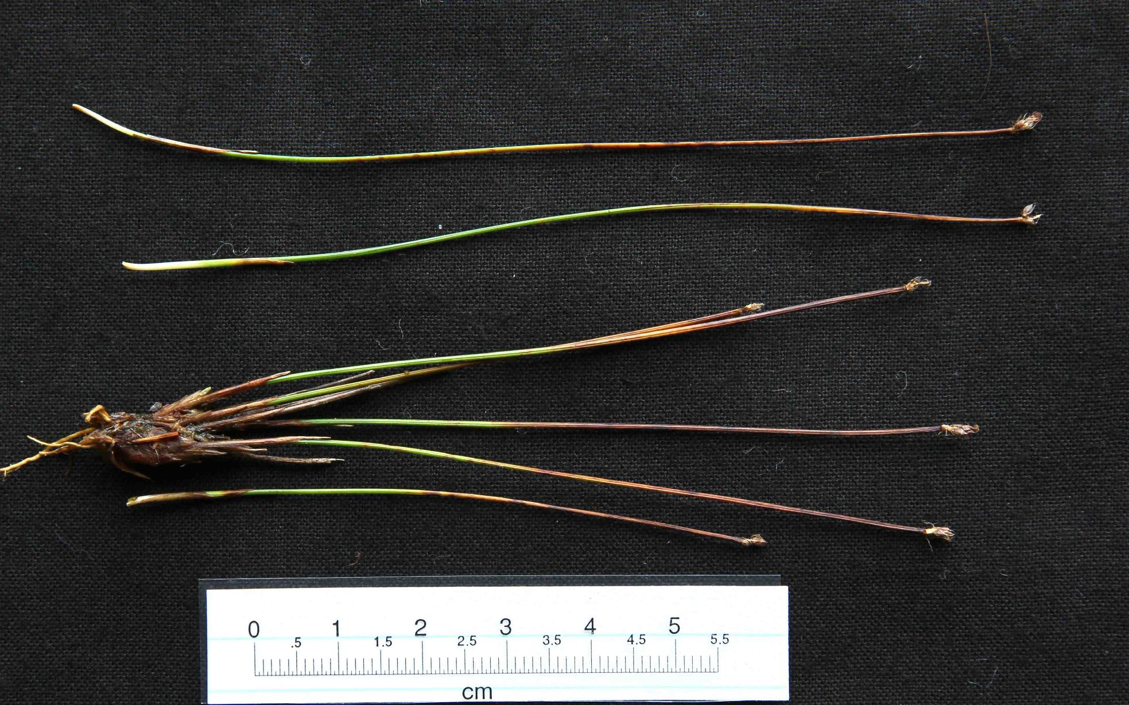
BUT beware ‘tiny’ stunted germanicum!!

Slide 61
Separation & Identification:
3
Stem cross-section
[needs compound microscope]

Slide 62
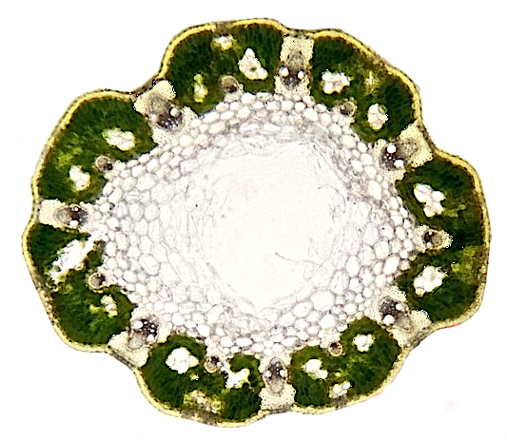

Northern Deergrass
Trichophorum cespitosum
Stem cross-sections
Common Deergrass
Trichophorum germanicum

Slide 63

Putative internal structure of longitudinal stem-section
[view on website with explanation]

Slide 64
T. germanicum: stem-section

Slide 65

Also on website …

Slide 66

germanicum
beware: these are NOT substomatal cavities!

Slide 67


germanicum, variation

Slide 68

germanicum
substomatal pit ~ tiny!
stoma
guard-cells

Slide 69

germanicum
this is a pocket of aerenchyma, NOT a substomatal pit!
substomatal pit ~ tiny, crushed!
stoma guard cells

Slide 70
T. cespitosum: stem-section

Slide 71

Also on website …

Slide 72

cespitosum
LARGE substomatal pits, often paired
lining of tiny clear cells

Slide 73

cespitosum, variation

Slide 74

cespitosum, variation

Slide 75
T. × foersteri: stem-section

Slide 76

Northern Deergrass
T. cespitosum
Common Deergrass
T. germanicum
comparison
Hybrid Deergrass
T. × foersteri

Slide 77
[Repeated slide for clarification … putative internal structure]

Slide 78

Also on website …

Slide 79

× foersteri
substomatal pits OBVIOUS, but SMALLER than in cespitosum

Slide 80

× foersteri
substomatal pits OBVIOUS, but SMALLER than in cespitosum
‘islets’ of clear cells within green tissue, variable in size and number; may even be lacking!

Slide 81

× foersteri
substomatal pits not all cleanly ‘cut through’
× foersteri
‘islets’ of clear cells within green tissue

Slide 82

obvious substomatal pits, so clearly × foersteri, but the hybrid only VERY rarely has ‘islets’ this large!
? possible backcrossing ?

Slide 83
Finally,

Slide 84
… could we have FOUR Trichophorums??
There was
Trichophorum alpinum, Moss of Restenneth, 1791

Slide 85

Cotton Deergrass Trichophorum alpinum
(Norway)
… ‘like a tiny patch-forming Eriophorum’

Slide 86

Cotton Deergrass Trichophorum alpinum
(Norway)

Slide 87
Links to:
a lot more more information on the genus,
and the downloadable field-guide

